Slide 1

Growth Mindset
Friends of Johnston ELP March 23, 2017
Catherine Gillespie & Robyn Cooper

Slide 2
Theoretical Background
  Motivation and Learning Theory
    Can I do this?
      Based on one’s self-efficacy, attributions, beliefs about knowledge acquisition, and views on ability
    Do I want to do this?
      Based on goals, self-determination, and interests
      This presentation focuses on the first question above and touches on goals as they relate to learning and Dweck’s (2006) mindsets

Slide 3
Theoretical Background
  Can I do this?
    Self-efficacy
      Belief in one’s ability to be successful in specific situations or to accomplish a specific task (Bandura, 1997, 1982)
    Attributions
      Explanations one generates about why events happen (Weiner, 2010; 1972)
      Attribute success or failure to factors within one’s control or outside of one’s self
      Attributions influence learners’ emotional reactions to success or failure, expectations for future success/failure, and effort and persistence (Ormrod, 2014)

Slide 4
Theoretical Background
  Can I do this?
    Beliefs about knowledge acquisition/intelligence
  Personal Epistemology: Beliefs regarding the nature and acquisition of knowledge impact learning (Hofer, 2001; Hofer & Pintrich, 2002)
  Naïve epistemic beliefs: learner has little agency in the learning process
  Epistemic Beliefs, Schommer (2013; 1990)
    Structure of knowledge (simple to complex)
    Stability of knowledge (certain to uncertain)
    Source of knowledge (omniscient authority to reason/evidence)
    Speed of learning (quick to gradual)
    Ability to learn (fixed to improvable)

Slide 5
Theoretical Background
  Can I do this: Mindset integrates with research in the 3 previous areas (Dweck, 2006)
      The view you adopt for yourself, profoundly affects the way you lead your life.
      A fixed mindset creates an urgency to prove yourself over and over (i.e., performance goals).
      The passion for stretching yourself and sticking to it, even (or especially) when it’s not going well, is the hallmark of a growth mindset. Angela Duckworth (2007) calls this “grit.”

Slide 6


Carol Dweck
http://www.youtube.com/watch?v=TTXrV0_3UjY

Slide 7
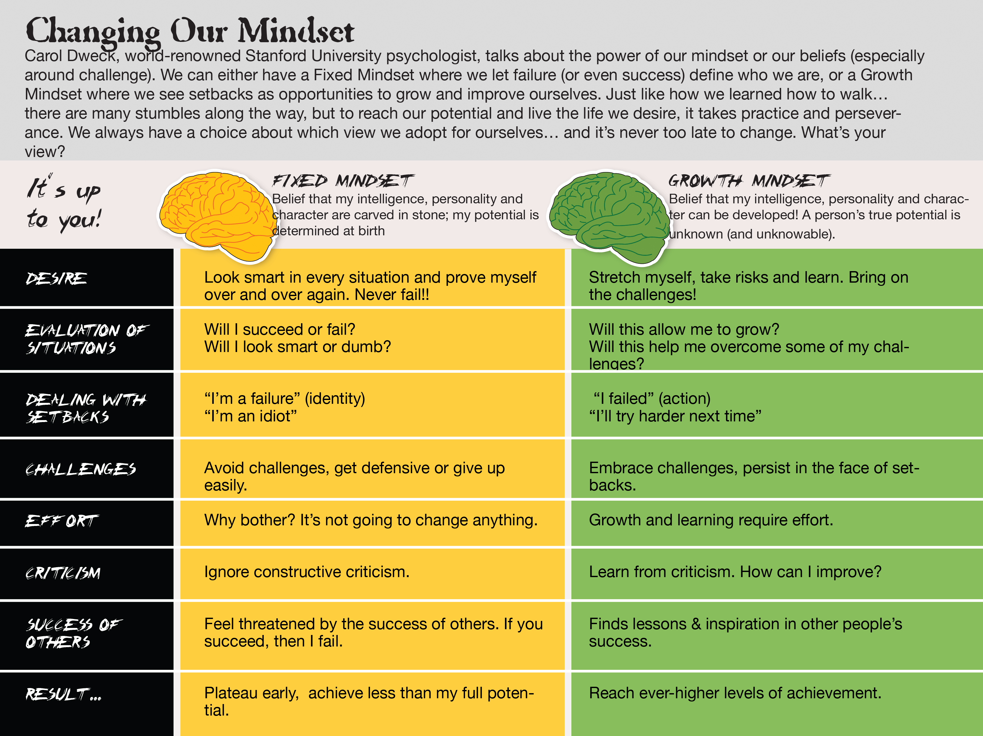
Notes:
#Fear of failure.

Slide 8
Mindset Characteristics (Dweck, 2006)
Fixed Mindset Entity Theory | Growth Mindset Incremental Theory
Intelligence is static. | Intelligence can be developed.
Learning is driven by Performance Goals | Learning is driven by Learning Goals

Slide 9
Fixed Mindset: Performance Goals
Believe competence is stable; people either have talent or don’t.
Choose tasks that maximize opportunities to demonstrate competence.
React to easy tasks with feelings of pride or relief.
View effort as a sign of low competence.
Motivated often by external factors.

Slide 10
Fixed Mindset: Performance Goals
Use strategies that promote rote learning.
Evaluate own performance in terms of how they compare to others.
View errors as a sign of failure and incompetence.
Are satisfied with their performance only if they succeed.
Interpret failure as a sign of low ability and therefore predictive of future failure.
View instructors as judges or evaluators.

Slide 11
Growth Mindset: Learning Goals
Believe competence develops over time through practice and effort.
Choose tasks that maximize opportunities for learning.
React to easy tasks with feelings of boredom or disappointment.
View effort as necessary to sharpen competence.
Motivated largely by intrinsic factors.
Use strategies that promote true comprehension.

Slide 12
Growth Mindset: Learning Goals
Evaluate own performance in terms of progress made.
View errors as normal and useful parts of the learning process; use errors to improve performance.
Are satisfied with performance when a great effort is made; even if the effort results in failure.
Interpret failure as a signal to exert additional effort.
View instructors as resources and guides who can assist in the learning process.

Slide 13
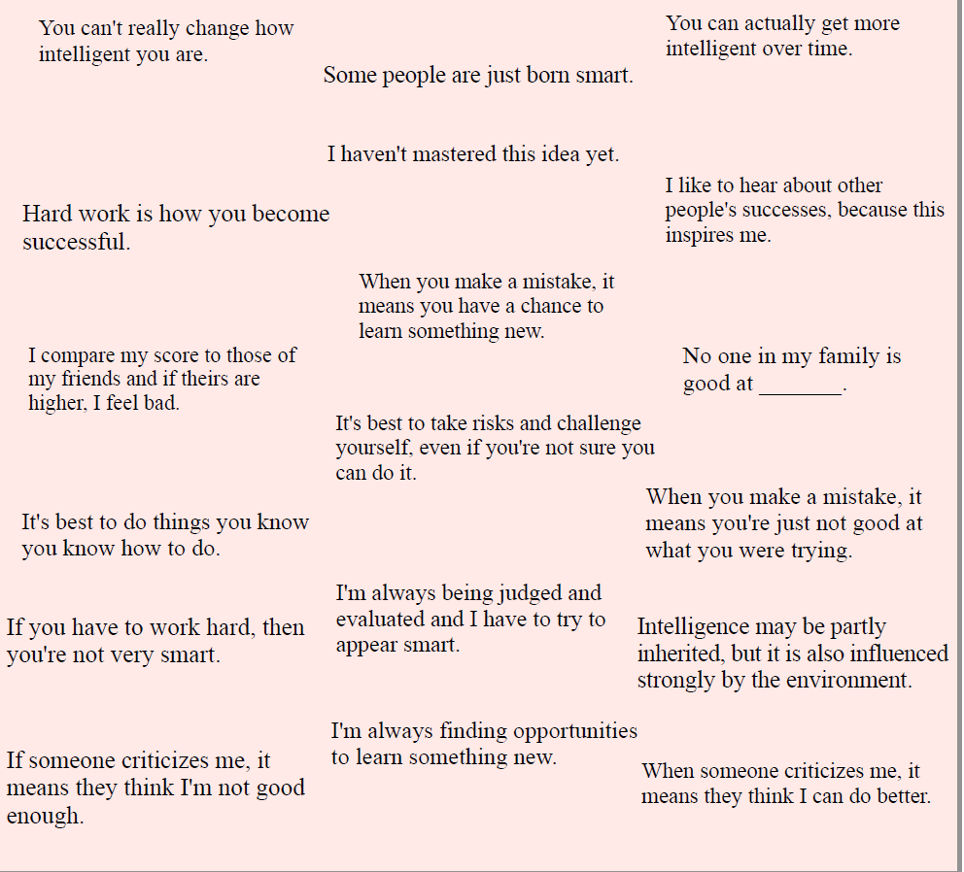

Slide 14
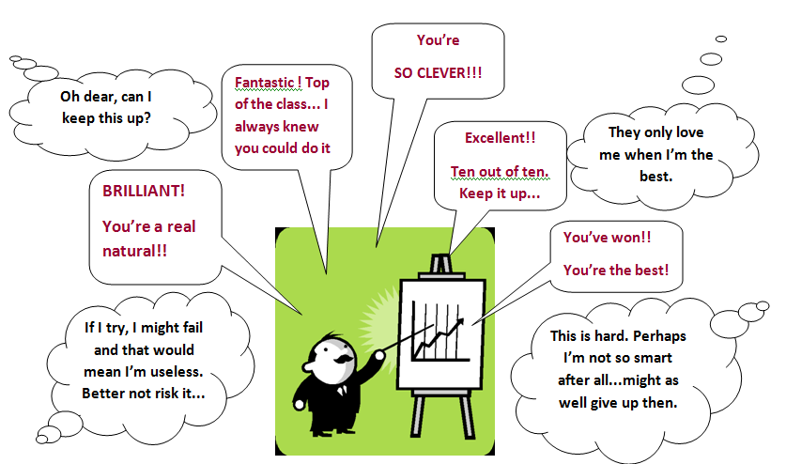
The impact of Praise AND feedback on Mindset

Slide 15

The Power of…
“Are you not smart enough to solve it or have you just not solved it yet?”
The philosophy of “not yet”
https://www.youtube.com/watch?v=_X0mgOOSpLU

Slide 16

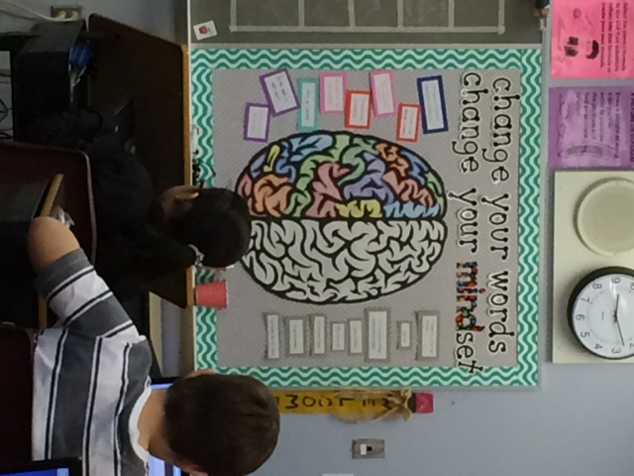
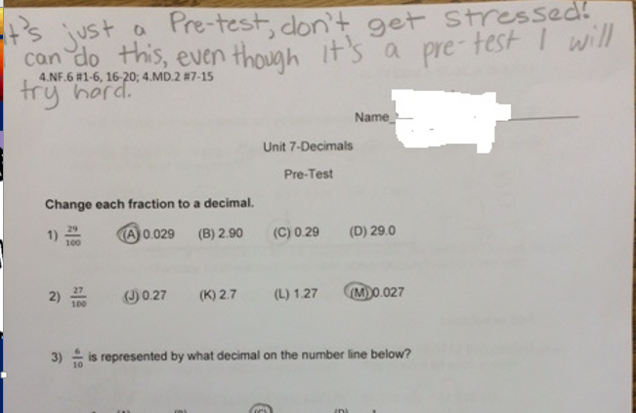
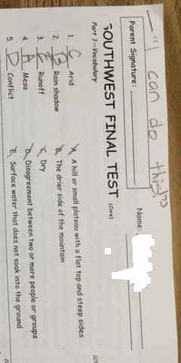
Our research
Notes:
Parent Interviews

Slide 17
Ways to instill a growth mindset
https://www.mindsetkit.org/growth-mindset-parents/how-parents-can-instill-growth-mindset/3-ways-parents-can-instill-growth-mindset

Slide 18
Fostering a Growth
INSTEAD OF… | TRY THINKING…
I’m not good at this | What am I missing?
I give up | I’ll use a different strategy
It’s good enough | Is this really my best work?
I can’t make this any better | I can always improve
This is too hard | This may take some time
I made a mistake | What did I learn?
I’ll never be that smart | I will learn how to do this
Plan A didn’t work | There’s always a Plan B
My colleague can do it, why can’t I | I will learn from them

Slide 19
Discussion and Questions

