Slide 1


Guiding Your gifted reader:
Suggestions and activities for parents
Notes:
A presentation developed for the Johnston School District by Professors Dede Small & Todd Hodgkinson from Drake University.

Slide 2
Bios
Dr. DeDe Small
Dr. Todd Hodgkinson
Faculty member at Drake University for 14 years.
Teaches coursework in Children’s and YA Literature, Literacy Methods in the Intermediate Grades, and Reading Across Different Content Areas.
Faculty member at Drake University for 2 years.
Teaches methods coursework in Secondary English Language Arts.
Former Gifted and Talented Coordinator and teacher in the Cherry Creek School District (Colorado).

Slide 3

Myths about gifted readers
Notes:
As we mentioned before, we are here to talk about…the characteristic/needs of the gifted reader, and how can parents to support the needs of this unique population…
Before starting out, we thought it might be appropriate to take some time to discuss some common myths about gifted readers.

Slide 4
Myths about gifted readers
Myth #1: All gifted readers are the same.
Myth #2: Gifted readers will flourish if left to their own devices.
Myth #3: Gifted readers are experts when it comes to comprehending and analyzing texts.
Myth #4: Gifted reader know how to select appropriate reading materials.
Wood, P. (2008). Reading instruction with gifted and talented readers. Gifted Child Today, 31 (3), 16-25.
Notes:
#1: With that, keep in mind that some of the strategies and approaches that we suggest might work with your child, and some simply will not. In the end, helping them requires knowing the intimately as a child and as a reader.
All too often, some people assume that b/c advanced readers, already experts when it comes to comprehending/analyzing, or selecting texts…
but as I’m sure many of you know/realize, this is far from true. In fact, we are doing our gifted students a disservice if we leave them to their own devices…
The problem is the discrepancy between the child’s intellectual and her social and emotional development. She can read the words, but does she understand the content? Is her imagination so lively that she creates mental images of violent scenes that are overwhelming to her? Is her knowledge of human sexuality sufficient to prepare her for what she might find in a book written for adults or older teens?

Slide 5

Characteristics of Gifted Readers
Source: http://www.hoagiesgifted.org’
Notes:
With that said…keeping in mind that gifted readers are not all the same, there are some common characteristics that many share…

Slide 6
Characteristics of Gifted Readers
read at an early age (and may be self-taught); read two grade-levels or above their peers.
read enthusiastically and widely (on to adulthood).
Have an expansive vocabulary and are able to used advanced terminology correctly.
Halsted, J.W.. (2009). Some of My Best Friends are Books. Scottsdale, AZ: Great Potential Press.
Notes:
I can see by the smiles and nods from a few of you that you are recognizing characteristics of your own child, yes?

Slide 7
Characteristics of Gifted Readers
Understand language subtleties and use language for humor; Display this ability in self-expression.
Write words and sentences early; write creatively.
Display evidence of divergent thinking.
Demonstrate flexibility of thought.
See relationships that others miss; transfer past learning to new situations.
Source: http://www.hoagiesgifted.org
Notes:
Such as irony or sarcasm.
Just as many read at an early age, many learn to write at an early age.
Finally…
Keep in mind these characteristics, b/c they are connected to ways you can help them grow as individuals and readers.

Slide 8

Needs of gifted readers

Slide 9
Needs of gifted readers
Texts with nuanced…
language (figurative language, playful wording, humor)
structure (different points of view; non-linear texts; reoccurring motifs and themes; provocative plot twists, story problems).
Provocative characters
Novel Ideas (utopias, dystopias, Alternative worlds)
Abilock, D. (1995). Literary club: Meaning making in a school community. School Libraries in Canada. Spring, 10-14.

Slide 10
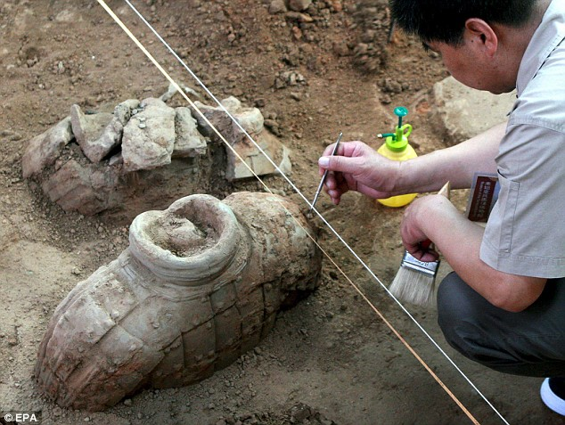
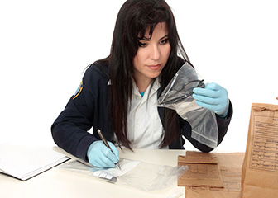

What Gifted
Readers need
Texts that…
Position the reader to think like an expert in a specific discipline.
Abilock, D. (1995). Literary club: Meaning making in a school community. School Libraries in Canada. Spring, 10-14.
Notes:
Professional role models

Slide 11

What gifted readers need
Texts that help them…
Establish an identity.
Allow them to escape.
Foster and maintain relationships with others.
Learn how to use their abilities.
Levande, D. (1999). Gifted readers and reading instruction. California Association for the Gifted. 30(1)
Notes:
Differences – Gifted children realize early that they are different. Books can help them embrace and celebrate their differences, and find characters with which they have something in common
Fiction can help guide emotional development because fiction is written to touch the emotions!
GT students can often identify with characters, even if unable to talk about their own problems.
GT students can acquire insight into their own lives and needs = bibliotherapy.
Learn to understand and own their giftedness.
Resolve dissonance between their perception of themselves and their performance.
Learn skills for dealing with intensity by exploring ways in which others cope with it.

Slide 12

Ways to support your gifted reader

Slide 13
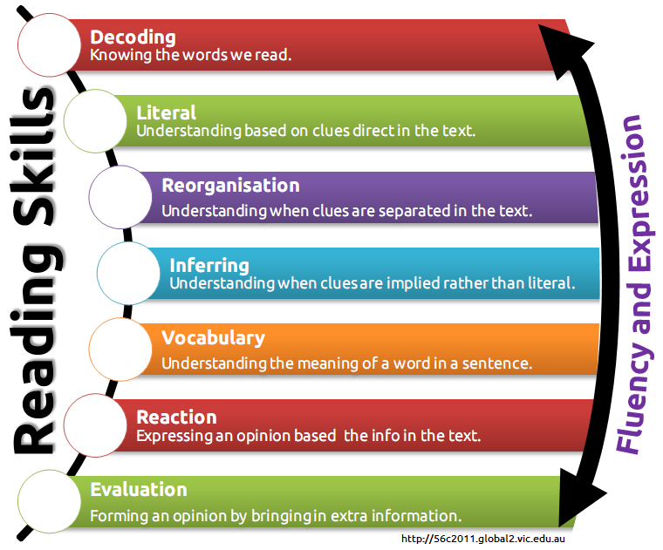

What is Reading?
As a skill
As Meaning-making

Slide 14
What is Reading?
Duffy (2009) points out that “What they do is what they think it is.”
Reading is constructing meaning from print in order:
  To understand
  To enjoy
  To interpret
  To apply their learning from reading to other areas
Duffy, G. (2009). Explaining Reading: A Resource for Teaching Concepts, Skills, and Strategies, 2nd Edition.

Slide 15
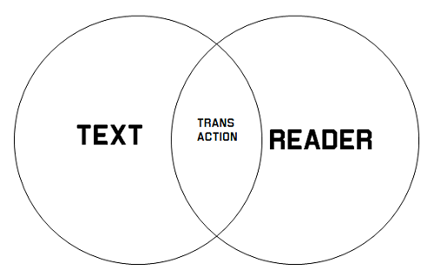
Transactional reading theory
Louise Rosenblatt published Literature as Exploration in 1938
  Hancock, M. R. (2000). A celebration of literature and response: Children, books, and teachers in K-8 classrooms. Upper Saddle River, NJ: Merrill / Prentice Hall

Slide 16
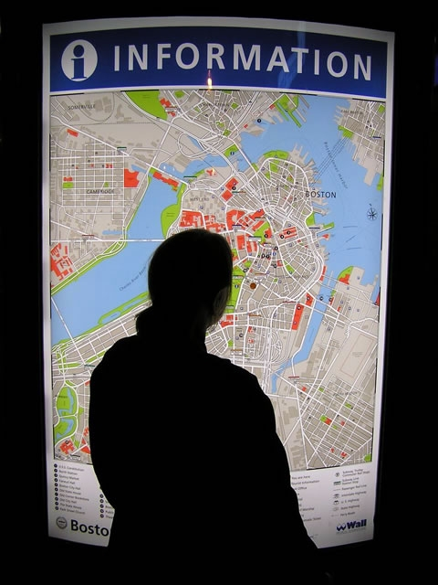

Transactional reading theory
The role of stance
  Efferent
  Aesthetic
  Hancock, M. R. (2000). A celebration of literature and response: Children, books, and teachers in K-8 classrooms. Upper Saddle River, NJ: Merrill / Prentice Hall

Slide 17
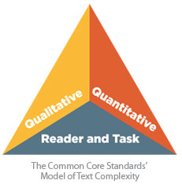
Text Complexity
“Text complexity is the new black” – Fisher, Frey & Lapp (2012)
  Fisher, D., Frey, N. & Lapp, D. (2012) Text Complexity: Raising Rigor in Reading

Slide 18
Text Complexity
Quantitative = word length, frequency, sentence length, etc.
Qualitative = figurative language, structure, theme.
Reader = motivation, life experience
Task = purpose of reading
  Fisher, D., Frey, N. & Lapp, D. (2012) Text Complexity: Raising Rigor in Reading
Notes:
readability

Slide 19
Text Complexity
“Anyway, the fascinating thing was that I read in National Geographic that there are more people alive now than have died in all of human history. In other words, if everyone wanted to play Hamlet at once, they couldn’t because there aren’t enough skulls.” (Foer, 2005, p. 3)
  Fisher, D., Frey, N. & Lapp, D. (2012) Text Complexity: Raising Rigor in Reading
Notes:
Reading level
Background knowledge (NG = exists to inform; Hamlet)
Huge concept “More people than…”

Slide 20

Using Text complexity theory to Helping your child select Books

Slide 21
Factors to consider when selecting a text
Quantitative/Qualitative aspects of Text
  Reading level
  Language
  Structure
  themes
Cognitive capabilities/Readiness
Interest/Motivation
Prior knowledge/Experiences
Purpose for reading (efferent or aesthetic)

Slide 22
Factors to consider when selecting a text
Format
  E-book
  Audio book
  Interactive
  Graphic text
Curriculum / CCSS

Slide 23

Factors to consider when selecting a text
Issues related to giftedness:
  Asynchronous development
  Sensitivity and intensity
  Awareness of moral issues
  Isolation
  underachievement
  Perfectionism
Source: http://www.hoagiesgifted.org’
Notes:
Personal crisis

Slide 24



Text selection resources
Hoagies’ Gifted Education Page

Slide 25

discussing texts with your child
Notes:
Another way you can support your gifted reader is by discussing texts with them…

Slide 26

Discuss texts with your child!
Open ended!
Facilitate vs. Direct
Try to help them recognize and build upon their response.
It is okay if you haven’t read the book!

Slide 27
Ask questions
Factual Questions = What happened?
Interpretive questions = Why did it happen?
Divergent questions = what if something else happened? If…, then…
Evaluative questions = what did you think about what happened? What would you have done?
Notes:
Start with the facts…what happened a) Did they read it; b) also puts children at ease; look for opportunities to ask; why do you think that happened

Slide 28
What gifted readers need
Texts that help them…
Establish an identity.
Allow them to escape.
Foster and maintain relationships with others.
Learn how to use their abilities.
Levande, D. (1999). Gifted readers and reading instruction. California Association for the Gifted. 30(1)
Notes:
Differences – Gifted children realize early that they are different. Books can help them embrace and celebrate their differences, and find characters with which they have something in common
Fiction can help guide emotional development because fiction is written to touch the emotions!
GT students can often identify with characters, even if unable to talk about their own problems.
GT students can acquire insight into their own lives and needs = bibliotherapy.
Learn to understand and own their giftedness.
Resolve dissonance between their perception of themselves and their performance.
Learn skills for dealing with intensity by exploring ways in which others cope with it.

Slide 29
Bibliotherapy
What is the main character’s biggest problem?
How do you think s/he feels when…?
Why is it hard to…?
When do you…?
Notes:
Bibliotherapy differs from intellectually-oriented book discussions in that the focus is on reader’s emotional response.

Slide 30

Bibliotherapy

Slide 31

Helping your child read closely

Slide 32

What is close reading?
“An intensive analysis of a text in order to come to terms with what it says, how it says it, and what it means.”
~ Tim Shanahan ~
Notes:
#1 carefully observe the information the author has presented us; avoid imputing own ideas, judgments, arguments, visions; avoid parroting the judgments/interpretations of others with our own assessment.
#2 integrate our interpretations.

Slide 33

What is close reading?
“Close reading should suggest close attention to the text; close attention to the relevant experience, thought, and memory of the reader; close attention to the responses and interpretations of other readers; and close attention to the interactions among those elements.”
~ Kylene Beers ~

Slide 34

Characteristics of close reading
works best with a short passages
Involves careful and purposeful re-reading.
Involves asking questions and making connections to other parts of the text
Notes:
What is going on?
Who is the speaker?
Language usage.
As a former middle school teacher…this is the thing that I struggled most with. Most of my students came in readign voraciously; love fo rreaidng but few if any new how to read a text closely. In fact, many of them lack the attention span, but when you think of the type of reading they often do in english class in high school; preparing for Ap exams, that’s exactly.

Slide 35

Reading like a writer
“I really think that reading is just as important as writing when you are trying to be a writer, because it’s the only apprenticeship we have, it’s the only way of learning how to write a story.”
Author, John Green

Slide 36
Reading like a writer
Texts as Mentors: Readers can note and emulate writers they like!
  Language Patterns
  Literary Elements
  Dialogue
  Imagery
  Text Structures
  Style
Notes:
Novel writing club. If they are struggling with a particular scene, search out books that have fight scenes ask teachers to help them.

Slide 37

Inquiry reading
“Inquiry reading offers gifted and talented readers with the opportunity to conduct independent research into an area of particular interest to them.”
~ Patricia Wood ~
Notes:
Finally, another way you can help support is by encouraging them to conduct independent studies into topics they love.

Slide 38
Inquiry reading
Students self-select a topic/problem of study.
Develop questions they wish to pursue.
Collect information.
Create a product that illustrates their understanding of topic/solution to the problem.
Notes:
Inquiry reading
Beyond looking up information…
Student takes on the role of….

Slide 39

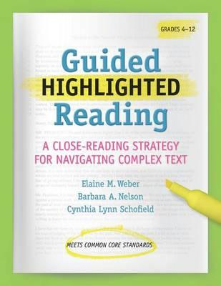
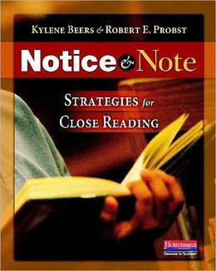
Textual resources

Slide 40

Online resources
  Book Adventure: http://www.bookadventure.com/Home.aspx
  School Library Journal: http://www.slj.com
  Hoagie’s Gifted Reading Lists: http://www.hoagiesgifted.org
Notes:
Even if you plan to teach out-of-state, it is essential that you apply for initial teacher license in Iowa. You will do this during

Slide 41
Works Cited
Beers, K. & Probst, R.E. (2013) Notice and note. Portsmouth, NH: Heinemann.
  Fisher, D., Frey, N. & Lapp, D. (2012) Text Complexity: Raising Rigor in Reading. Newark,
  DE: International Reading Association.
Halsted, J.W.. (2009). Some of My Best Friends are Books. Scottsdale, AZ: Great Potential
Press.
Levande, D. (1999). Gifted readers and reading instruction. California Association for the
Gifted. 30(1)
Recob, A. (2008) Bibliotherapy: When Kids Need Books: A Guide for Those in Need of
Reassurance and Their Teachers, Parents, and Friends. Bloomington, IN: iUniverse.
Wood, P. (2008). Reading instruction with gifted and talented readers. Gifted Child Today,
31 (3), 16-25.
Weber, E. & Nelson, B.A. (2012). Guided highlighted reading. Gainesville, FL: Maupin
House Publishing.
Notes:
Even if you plan to teach out-of-state, it is essential that you apply for initial teacher license in Iowa. You will do this during

Slide 42

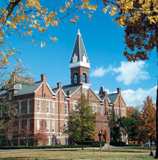
DeDe Small, PhD
Associate Professor of Education
dede.small@drake.edu
Todd Hodgkinson, PhD
Assistant Professor of Secondary Education
todd.hodgkinson@drake.edu

