Slide 1
Anxiety in Children and Adolescents
What to Look For

Slide 2
Normal Anxiety
Reaction to stress
Fight or flight response
Response to stress
Resolves after stress is removed
Appropriate at certain stages of development

Slide 3
Diagnosable anxiety
Excessively frightened, distressed, and uneasy during situations in which most others would not feel those symptoms

Slide 4
Characteristics of Anxiety Disorders
Interference in daily life
Overwhelming
Chronic
Common (10% possibly more)
Under diagnosed
No single cause, situational and/or neurochemical (serotonin)

Slide 5
Anxiety Disorders
Generalized Anxiety Disorder
Exaggerated worry about routine events
Separation Anxiety Disorder
Fearful and nervous when away from home or separated from a loved one
Social Anxiety Disorder
Hypersensitivity to criticism, difficulty being assertive, low self-esteem, performance issues

Slide 6
Obsessive Compulsive Disorder
Repeated, intrusive, and unwanted thoughts (obsessions) and/or rituals that seem impossible to control (compulsions)
Phobias
A disabling and irrational fear of something that really poses little or no actual danger
Panic Disorder
Sudden feelings of terror that strike repeatedly and without warning
Post Traumatic Stress Disorder
Persistent symptoms after experiencing a trauma such as abuse, natural disasters, or witnessed violence

Slide 7
Anxiety At School
Symptoms can look like other disorders…
ADHD
Depression
Oppositional Defiant Disorder

Slide 8
But with different causes…
Reaction to something AT school
Obsessions, compulsions, rituals
Needing to “finish
Fear of mistakes
Having something “just right”
Wanting to be “safe” at home
Wanting to check on family members
Ruminating
Overwhelmed by time constraints

Slide 9
Behaviors
Uptight, overly tense
Vigilant
Needs reassurance
Avoids activities, school refusal
Eager to please
Unable to participate
Easily overwhelmed

Slide 10
More Behaviors
Tantrums
Appear dependent, withdrawn, or uneasy
Either overly restrained or overly emotional
Perfectionist or rushes
Difficulty with assignments
Timed activities and Tests are difficult

Slide 11
More Physical Symptoms
Hyperventilating
Trembling
Startles easily
Tiredness/fatigue
Cries easily

Slide 12
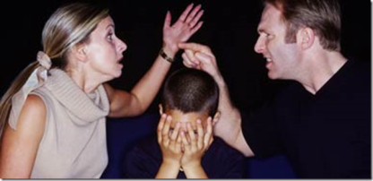
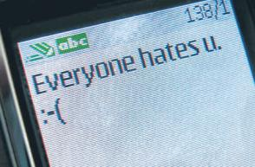
External External Triggers
Transitions
A.M.s, weekend to week, switching grade levels
Home stressors
Divorce, death, financial problems, illness, moving
School issues
Bullying, social problems, learning problems, conflicts with teachers, sensitivity to environment

Slide 13
Internal Triggers
What If…?
Individual thoughts
Fears, concern about others, “mind loop”
Anticipation
Performance, reactions from others
Environmental fears
Someone getting angry, contamination, what others are doing

Slide 14
What Can Help?
Awareness
Anxiety is possible and more common than we might think
Something at school may be triggering the response
Knowledge
Signs and symptoms
Use available resources such as parents, treatment team, Internet for information
Understanding
Symptoms may not be obvious in classroom
The problem may not be what it appears to be

Slide 15
Adapting the Environment
Transition plans
Having safe person(s) to talk to
Being on premises but in a “safe place”
Breaks to regroup
Not having to wait to use their management plan
Ability to use coping mechanisms to calm down away from others i.e. deep, patterned breathing, relaxation, music, talking to a trusted person

Slide 16
More Adaptations
Talking about issues away from others
Removing time constraints
Extra time for assignments
Break assignments into smaller pieces
Take tests in private or with more time
Alternatives to public speaking
Routine and preparation if there is a change
Written instructions
Seeing new work in advance

Slide 17
And Remember….
Anxiety is difficult to manage even for adults with more life experience.
Children and adolescents need our help and understanding when learning to deal with anxiety and function in their daily lives!

Slide 18
Help Is Available
Call Insurance Company to find out….
If Mental Health/Behavioral Health are covered on your plan
What clinics they cover
If you need a referral from them to the clinic

Slide 19
Area Service Providers
UnityPoint Health – Des Moines
Student Assistance Program 263-4004
UnityPoint Health – Des Moines
Counseling & Psychiatry 241-2300
Des Moines Pastoral Counseling Center 274-4006
Orchard Place Child Guidance Center 244-2267

Slide 20
Resources
National Alliance on Mental Illness
www.nami.org
American Academy of Child and Adolescent Psychiatry
www.aacap.org
International OCD Foundation
www.ocfoundation.org
National Institute of Mental Health
www.nimh.nih.gov

