Slide 1

Johnston Community Schools
Extended Learning Program (JELP)
Johnston Middle School
Library
Mon. March 23, 2015 7-8:30 pm
Sally R. Beisser, Ph.D.
Drake University
Sex, Gender and School: What do
Parents & Teachers Need to Know?
Notes:
Interested in this topic for over 25 years.

Slide 2

Purposes
Advance parental/teacher understanding of sex and gender generalizations
  Not applicable or descriptive of all children
  Not applicable or descriptive of all GT children
  Important for advancing the development and nurturance of high ability learners
  Create topics of discussion
  Be a scholar of your child
Notes:
Not necessarily applicable in my own HOUSE!

Slide 3
Definitions
Define sex (n):
1. either the male or female division of a species, especially as differentiated with reference to the reproductive functions.
2. the sum of the structural and functional differences as males and females are distinguished, or the phenomena or behavior dependent on these differences.
3. the instinct or attraction drawing one sex toward another, or its manifestation in life and conduct.
Define gender:
1. refers to the socially constructed roles, behaviors, activities, and attributes that a given society considers appropriate for men and women.
2. To put it another way: "Male" and ”Female" are sex categories, while "masculine" and "feminine" are gender categories.
Notes:
Biological distinction…boy or girl at birth

Slide 4
What is Giftedness?
“What educators and psychologists recognize as giftedness is really potential giftedness which denotes promise rather than fulfillment and probabilities rather than certainties about future accomplishments.
-Dr. Harry Passow

Slide 5
What is giftedness?
How high these probabilities are, in any given case, depends much on the match between a child’s budding talent and the kinds of nurturance provided.”
Source: http://www.nytimes.com/1996/03/29/us/a-harry-passow-75-dies-studied-gifted-pupils.html

Slide 6

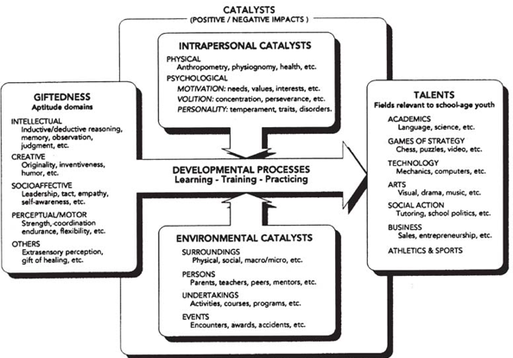

What is giftedness?
Dr. Françoys Gagné (1985)
Notes:
1985 same year as Sternberg. Synthesized BOTH camps….intelligence AND talent. Believes Giftedness is natural ability…argues giftedness must
eventuate” in distinction in a specific field!
NATURAL GIFTEDNESS: Intellectual, Creative, Social, Perceptual/Motor
Influenced by “chance” and “environment”—where TEACHERS come in…Environmental Catalysts (below) such as surroundings, persons, undertakings, events.
TALENTS: Can you think of famous people in Academics, Games of Strategy, Technology, Arts, Social Action, Business, Athletics/Sports
Need intrapersonal catalysts to make it happen! Need motivation, volution, personality.

Slide 7

Sex and Gender Questions:
Did you grow up with brothers and/or sisters?
Do you teach or parent girls and boys differently?
Do boys and girls behave differently in school?
Do you think gender barriers impact learning?
Notes:
YOUR childhood BOY-GIRL parenting was probably different!
You were …Dressed in pink and blue
Boys allowed to cry longer before comforting them
Boys are HELD differently….boys face outward (to the world)
Girls HELD close and tend to nuzzle and nurtured
Given different TOYS—CHOSE different toys!
Boys can play farther away from their neighborhood houses-bigger circle
Disciplined differently

Slide 8
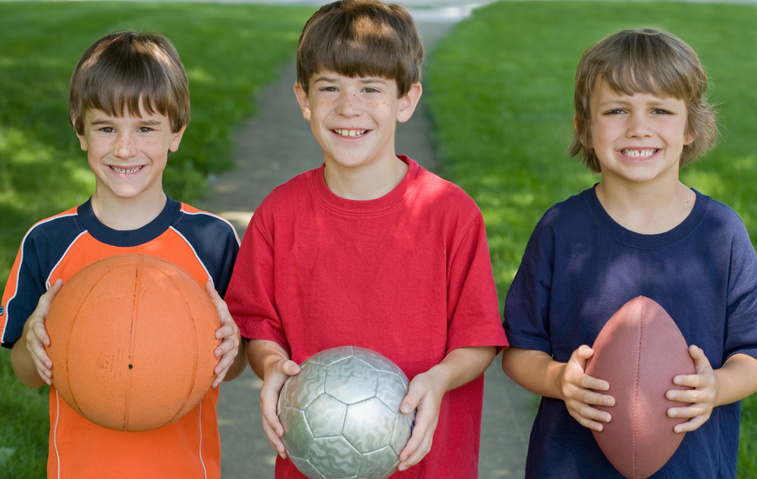
Facts about Boys in School
(Dr. Gary Davis & Dr. Sylvia Rimm, 2004)
Boys are……..
More likely to be underachievers in class
More likely to have learning & behavior problems
Are 5 times more likely to stutter
Develop more slowly than girls
Aren’t as strong as girls in verbal skills
More likely to have ADHD
More likely to be autistic
More boys are involved in violence and crime
Boys need to move, move, move (so do girls!)
Notes:
May occur in GT population of boys or NOT.

Slide 9


Facts about Girls in School
Dr. Gary Davis & Dr. Sylvia Rimm, 2004
Girls are…...
More likely to be teacher pleasers
More likely to comply and conform to “rules”
Choose social play on the playground; Like groups
Develop faster than boys or brothers
Advanced verbal skills
Less likely to get called on despite high verbal skills
May be content to let the boys take over
Interested in social harmony
Responsive to emotions of others
(e.g., drama, gossip, group association, etc.)
Notes:
May occur in GT population of girls or NOT.

Slide 10


Are there fundamental differences?
Dr. Louann Brizendine, M.D.
Is it….hormonal or socialized???
Brains start out as similar in utero
At 8 weeks there is a “fetal fork in the road”
Testosterone surge in utero shrinks boy “centers”-i.e., Communication, Emotion, Reading Body Cues
Baby girls: Keen eye contact & mutual face gazing
Baby boys: Compelled to investigate environment
Are differences hardwired or socialized?
Notes:
NOTES: Female brains have larger communication centers
Emotional memory is bigger in girl brains than boy brains (girls hold a grudge, women remember faults for decades, boys settle it and that’s that)
Girl brains have greater ability to read cues in people than boys brains (guys don’t get ‘the look’ like girls do! You can make girls cry with a mad face!)
In THREE months….baby girls skills in facial gazing, eye contact increase by 400% and baby boys skills do not increase AT ALL!
Girls DO not tolerate FLAT faces!
Boys do not HEAR the tones of warning from their mothers…..even forbidden environments…
It is not how they were raised…it is how they ARE!
Ex. From Why Men Never Remember & Women Never forget….cave men wired up to not remember danger or they’d never hunt that field again…women wired up to never forget danger to protect clan.

Slide 11

Girls and Boys
Dr. Louann Brizendine, M.D.
Girls: social, verbal, relational skills develop earlier than boys. Easily bossy. Gets her way. Has daddy “wrapped around her little finger”
Boys: wrestling, mock fighting, rough play with cars, trucks, swords, guns, and noisy toys (preferably explosive)
Girls: Take turns 20 times more than boys and their pretend play involves caregiving & nurturing
Boys: Not about relationships…more about social rank, power, defense of territory & physical strength.

Slide 12

The Female Brain
Dr. Louann Brizendine, M.D.
Girls have superior wiring for empathy
Estrogen surge enhances observation, communication, gut feelings, tending, caring, mastery of social nuances.
Girls are interested in preserving harmonious relationships and to stay connected.
“Genderlect” matters! (Tannen, 2005)
  Girls: Let’s play house….you be the teacher.
  Boys: My dad is bigger than yours….brag, threaten, ignore. Do not look for connections like girls do.
  Women have “rapport” talk….Men have “report” talk.
Notes:
ESTROGEN: This promotes fertility—girls are masterful at flirting….emotionally adept even while in diapers!
CAN YOU THINK of EXAMPLES of Girls and harmony or connectedness??

Slide 13


The Male Brain
Dr. Louann Brizendine, M.D.
Boys pummel each other with gusto, wrestle, compete for toys and power.
Losing is unacceptable even in board games.
Boys are geared for play-fighting, defending, competing…the “victory cry” is everything.
Bragging rights about burping and farting.
Settle conflicts then move on.
Notes:
Is this why guys just love sports—playing them and watching them….embracing the win and suffering the loss?

Slide 14


The Male Brain
Dr. Louann Brizendine, M.D.
Boy days are filled with a physical conquests.
1st graders: Physical force + insults = fun.
Geared for play-fighting, defending, competing…This is observed world wide in boys…not as much in girls.
Boys Like scary movies, haunted houses, “dares”
Little boys are “playing” at things they are
required do to in their futures.
Notes:
Get a PHYSICAL RUSH – massive FEEL GOOD rush in the form of dopamine-neurochemical that is addicting.
GIRLS get a physical RUSH from activity, as well. BE AWARE of what GIRLS do at recess. Inactivity? Four square, jump rope, talking? Boys: Interactive games that continue the next recess or the next day/

Slide 15
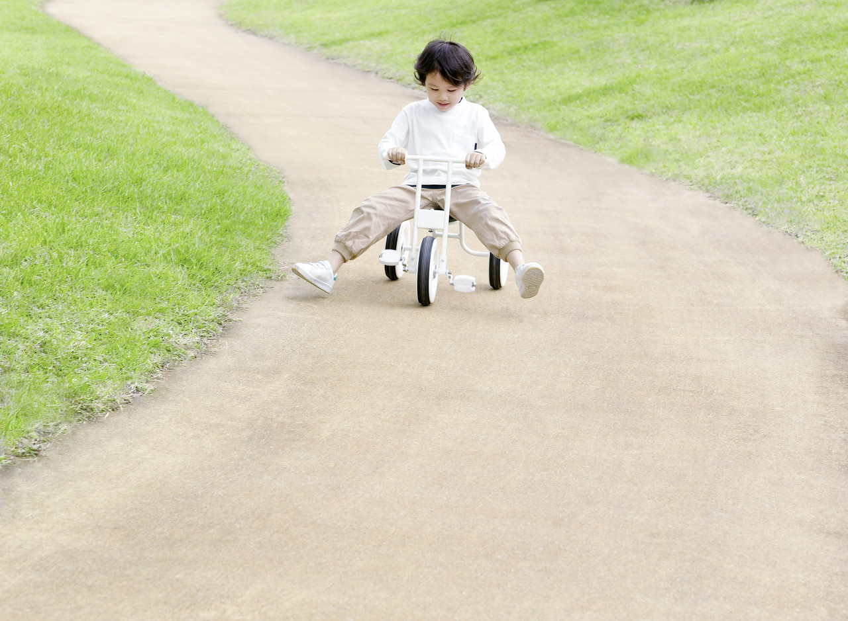
The Male Brain
Dr. Louann Brizendine, M.D.
Study of boys (1st gr): What other boys said mattered most, what teachers said was second and what girls said was a distant third!
Study in Ireland (Kdg): Boys monopolized the tricycles, played ramming games, territorial and possessive. Girls unwilling to hit other kids’ bikes ….providing girls “got a turn!”
Power matters: e.g., being first in line
Quick to establish dominance and
hierarchy within group play
Know how to succeed: Alliance with the “alpha boy”
Notes:
SAME SEX PLAY common and desired by boys and girls in school

Slide 16

The Male Brain in Elementary
Dr. Louann Brizendine, M.D.
Squiggling boys learn better! (repeat this)
Boy’s body movements have meaning…explain things by moving…words get in the way (p. 27)
Boys advanced at mental rotation of objects
About age 11…dawn of puberty. Testosterone and “androstenedione.”
Needs to prove himself; fight for his place
Preoccupied with sexual information
Notes:
…not man smell…a BOY smell
Androstenedione is a PHEROMONE
Pronounced…An-DRO-STEN-ED-EEE-ONE
Androstenedione is the common precursor of male and female sex hormones

Slide 17

The Male Brain in Middle School
Dr. Louann Brizendine, M.D.
Turn off your computer….parents alarmed
Millions of little “androgen switches” turn on
“Sexual preoccupation is like a large screen TV in a sports bar….always turned on.”
Testosterone + vasopressin = male fight or flight; territorial, sensitive to peer put-downs
Middle school boys are not trying to be difficult…their brains are not wired up yet for the future.
Sleepy? Bored? Hide emotions? Tuning out? Posturing? Bluffing? Blind to consequences? Yep.
Notes:
Vasopressin: Increases male aggression
BOYS-See the world through MALE colored glasses!
.

Slide 18

Middle School Females:
Internal and External Barriers
Dr. Barbara Kerr, Ph.D.
External:
Shaping for Femininity -clothing, handling, child rearing, feedback, stereotypical goals
Lack of Resources-employment practices, “career ceiling effect” and mentoring
Sexism and Discrimination -inadequate education, lack of support, constraints
Internal:
Horner Effect-deliberate, unconscious tendency to underachieve in competing with males
Imposter Syndrome-feeling “lucky” rather than skilled when promoted or recognized; Attribute syndrome (Callahan & Eccles research)
*Research Study on boys and girls fixing a bicycle
Cinderella Complex-someone will rescue you...must have a boyfriend or mate to be OK.
Boys
Girls
Notes:
Carolyn Callahan & Jacqueline Eccles
Behind a discrete observation window—psychologists watched a team of boys in one room and a team of girls in another room trying to fix a broken bicycle. Given same tools. Follow up interview:
Girls: final assessment “We couldn’t FIX IT”
Boys: final assessment “The bicycle couldn’t BE FIXED.”
GIRLS….Be intentional about Financial Literacy of your girls/daughters. Ex. Money Smart Week on Drake’s campus Sat May 12, 2014 (FREE!)

Slide 19
Surviving Adolescence
Dr. Mary Pipher, Ph.D.
Reviving Ophelia (Mary Pipher, 2005)
Adolescence: “Girls are like saplings in a hurricane.”
Adolescence is where girls stop “being” and start “seeming”
Adolescence is when “girls who once stood atop the playground gym equipment in order to rule the world and wished to run for president....now fade into silenced definition of a former self.”
Notes:
Everybody who has survived adolescence knows what a scary, tumultuous, exciting time it is. But if we use memories of our experiences to guide our understanding of what today's girls are living through, we make a serious mistake. Our daughters are living in a new world. Reviving Ophelia is a call to arms from Dr. Mary Pipher, a psychologist who has worked with teenagers for decades. She finds that in spite of the women's movement, which has empowered adult women in some ways, teenage girls today are having a harder time than ever before because of higher levels of violence and sexism. The current crises of adolescence - frequent suicide attempts, dropping out of school and running away from home, teenage pregnancies in unprecedented numbers, and an epidemic of eating disorders - are caused not so much by "dysfunctional families" or incorrect messages from parents as by our media-saturated, lookist, girl-destroying culture. Young teenagers are not developmentally equipped to meet the challenges that confront them.

Slide 20
Gender in the Classroom
WHAT TEACHERS DO | THE MESSAGE STUDENTS GET
•Boys answer without being called on, teachers accept it. Girls answer without being called on, teachers give negative response. •Believe that boys have innate talent and skill in mathematics and sciences. •Provide a curriculum that represents only one gender, one race, one socioeconomic class, one perspective. | • “Boys should be academically assertive and grab teachers attention; girls should act like ladies and keep quiet” (Myra & Sadker, 1985, as quoted by Reis; p. 72). • The performance and work of women in STEM fields is inherently lesser than men’s. • Women have not contributed historically, women cannot contribute to the future. There is no role model or place for girls
Notes:
From NAGC session on Gender (Dr. Barbara Kerr)

Slide 21
Confront Stereotypes
Shirt says “girls are too pretty to do homework.”

Slide 22

Confront Stereotypes
Compelling Book: The Lolita Effect: Sexualization of Pre-Teen Girls (2009) by M. Gigi Durham, Ph.D.
Notes:
Barbie as a role “model?”
Compelling Book: The Lolita Effect: Sexualization of Pre-Teen Girls-for Teens and Tweens

Slide 23
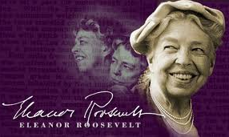

Gifted Kids Need Challenge!
“The surest way to make it hard for children is to make it easy.”
Eleanor Roosevelt, Woman of the Century

Slide 24

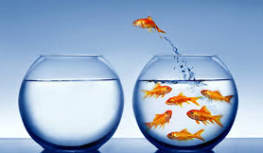
Challenge is Good!
The dictionary is the only place
where SUCCESS comes before WORK!

Slide 25
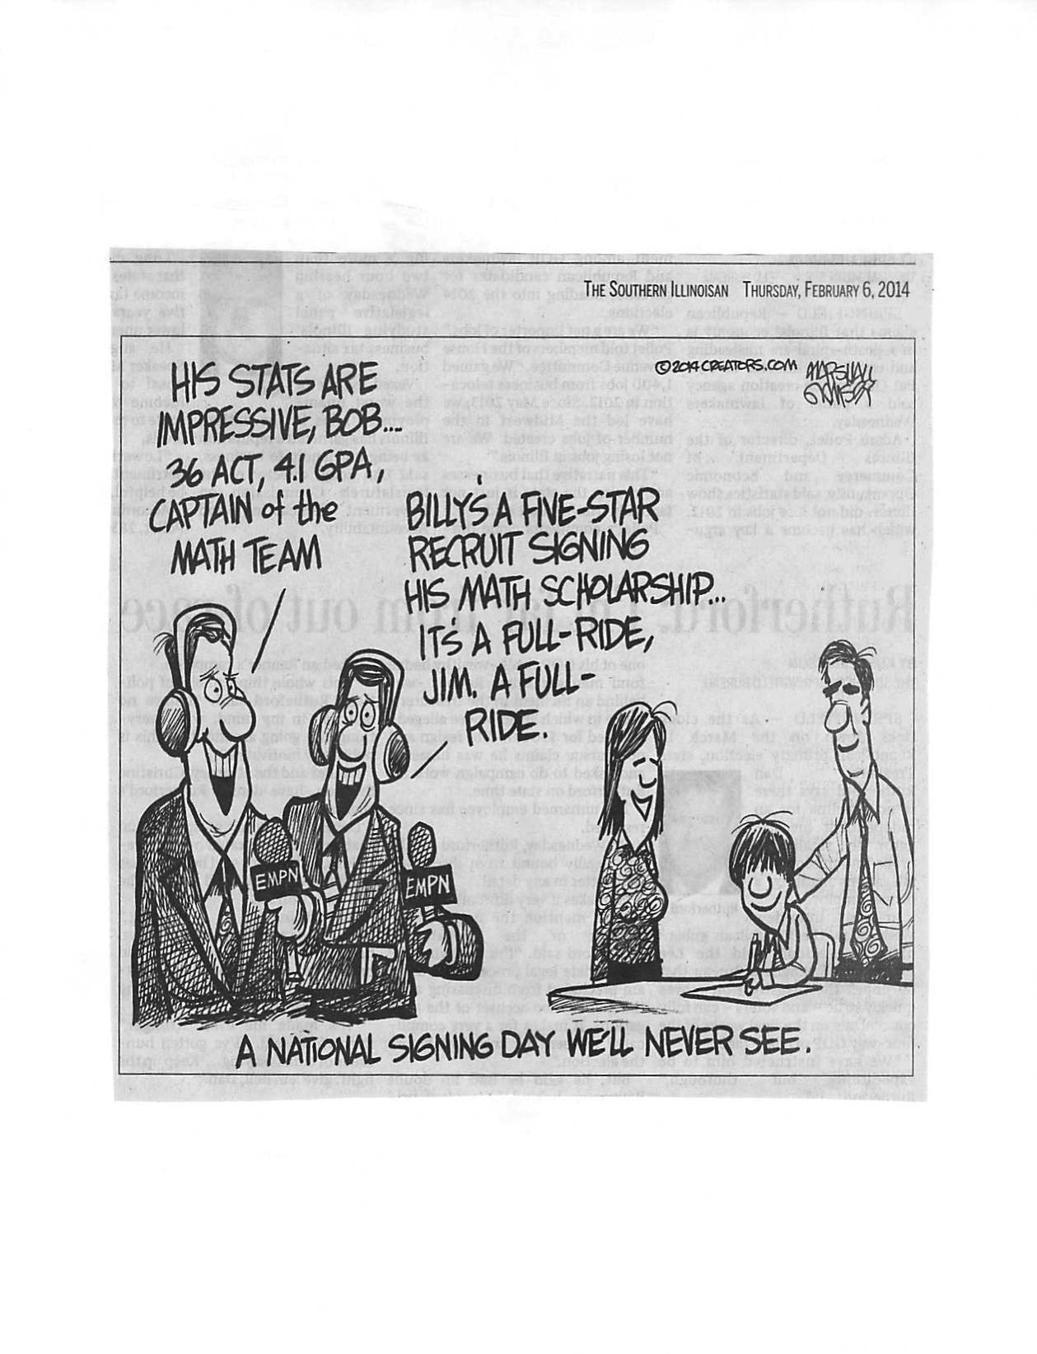
Celebrate Academics

Slide 26

Let Them Work Together
"In performance areas, it is generally accepted that you put high performers together...
Not one country sent a mixed ability team to the Olympics."
Professor Miraca Gross, Ph.D.
Australia

Slide 27
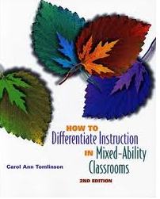
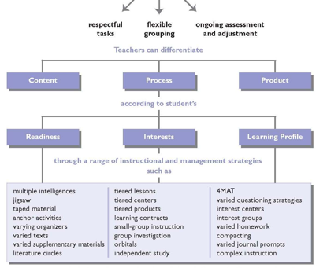
Let Them Work Differently
Notes:
Thankful to Andrea’s 7th gr LIFE SCIENCE teacher in AMES Community Schools. Didn’t make her work in a coop learning group!!

Slide 28
Research on GT students (Chapin, 2013)
Early 1990s Concern: “Mis-education” of girls and women who are overlooked and underserved.
Net result: Gender stereotype of both sexes.
Global concern that females lacked attention especially in developing nations.
Late 1990s Concern: Gender in schools not just an issue for girls. Suspension rate higher (3x) for boys and dropout rate higher. More boys in special education and on medications.
Notes:
Schools advantaged boys and females had less attention from teachers and not asked higher level questions
Multi education- history books weak on contributions of women.
Heroes were male, strong, aggressive

Slide 29
Research on Achievement: NAEP
Math Scores: Gender gap favors males (69%)
Reading Scores: Gender gap favors females.
Attendance: Females in all races have a higher HS graduation rate than males.
Monetary Earnings: Female college graduates earn, on the average, less than men in similar jobs with same degrees.
Graduate degrees: More women are now earning graduate degrees than ever before.
Notes:
Math and boys….Reading and girls…..still stereotypical.
Women earn less.

Slide 30
Research on GT students:
Female Science professors benefit GT girls (Young, Rudman, Buettner & McLean, 2013)
Acceleration is an underutilized strategy influenced largely by attitudes of parents.
(Siegle, Wilson & Little, 2013)
Interests and cognitive abilities research help determine college major choices for males and females. Clear implications for career counseling.
(Passler & Hell, 2012)
Notes:
Psychology of Women Quarterly September 2013 vol. 37 no. 3 283-292
1. The Influence of Female Role Models on Women’s Implicit Science Cognitions
Danielle M. Young1⇑
Laurie A. Rudman1
Helen M. Buettner2
Meghan C. McLean1
¹Department of Psychology, Rutgers University, New Brunswick, NJ, USA
²Department of Biomedical Engineering, Rutgers University, New Brunswick, NJ, USA
Danielle M. Young, Department of Psychology, Tillett Hall, Rutgers The State University of New Jersey, 53 Avenue E, Piscataway, NJ 08854, USA. Email: danielle.young@rutgers.edu
Abstract
Can female science professors benefit women? Women’s negative implicit cognitions about science, technology, engineering, and mathematics (STEM) disciplines impact performance in these fields, marking implicit associations as a space for potential change to improve women’s participation in STEM. Examining college student science majors (N = 320, 63% women) enrolled in chemistry and engineering courses, our study investigates how meaningful contact with female role models impacts women’s implicit cognitions about STEM. We used the Implicit Association Test to measure attitudes toward science, identification with science, and gendered stereotypes about science, and we compared students with female versus male professors. Our study first demonstrates both direct and indirect paths between implicit cognitions and women’s career aspirations in STEM. Next, when female professors were seen as positive role models, women automatically identified with science and stereotyped science as more feminine than masculine. Moreover, viewing professors as positive role models was associated with pro-science career aspirations and attitudes (both implicit and explicit), for men and women alike. The findings suggest that female science professors benefit women provided students identify with them as role models. We conclude that female STEM professors not only provide positive role models for women, but they also help to reduce the implicit stereotype that science is masculine in the culture-at-large. We further discuss how shifting implicit gendered stereotypes about science can impact women’s investment in a science career.
2. A Sample of Gifted and Talented Educators’ Attitudes About Academic Acceleration
doi: 10.1177/1932202X12472491
Journal of Advanced Academics February 2013 vol. 24 no. 1 27-51
Del Siegle1
Hope E. Wilson2
Catherine A. Little1
¹University of Connecticut, Storrs, USA ²University of North Florida, Jacksonville, USA Del Siegle, Department of Educational Psychology, University of Connecticut, 249 Glenbrook Road Unit 3064, Storrs, CT 06269-3064, USA. Email: del.siegle@uconn.edu
Abstract
Despite extensive research supporting its use, including the 2004 publication of A Nation Deceived, acceleration is an underutilized strategy for meeting the academic needs of gifted and talented students. Parents’ and educators’ attitudes and beliefs about acceleration influence the extent to which it is implemented in schools. This study investigated gifted and talented educators’ attitudes toward acceleration using a 7-point rating scale measuring concerns about acceleration, beliefs about acceleration, and support for specific acceleration strategies. Data indicated there were no differences in attitudes among teachers from rural, suburban, or urban school districts. Overall, the least popular acceleration strategies were also the easiest to implement, but caused the greatest change in students’ environments (i.e., grade-skipping and early entrance to kindergarten). As expected, the educators were most troubled by social issues and least concerned about academic issues related to acceleration.
3. Do Interests and Cognitive Abilities Help Explain College Major Choice Equally Well for Women and Men?
Journal of Career Assessment November 2012 vol. 20 no. 4 479-496
Katja Päßler1⇓
Benedikt Hell2
¹Department of Psychology, University of Konstanz, Konstanz, Germany ²School of Applied Psychology, University of Applied Sciences Northwestern Switzerland, Olten, Switzerland Katja Päßler, Department of Psychology, University of Konstanz, Konstanz, Germany Email: katja.paessler@uni-konstanz.de
Abstract
The present study examines whether vocational interests, measured by Holland’s RIASEC model, and objectively assessed cognitive abilities, were useful in discriminating among various major categories for a sample of 1990 German university students. Interests and specific abilities, in combination, significantly discriminated among major categories and furthermore, ability measures added incremental validity to prediction based on interest measures alone. Logistic regression analyses revealed significant differences in predictor importance between women and men. Furthermore, overall gender differences in interests and cognitive abilities were identifiable within major categories as well. Implications for career counseling are discussed.

Slide 31
Take Away Messages
Gap “is” closing in STEM sciences…girls can do math and science!
Don’t “red shirt” smart boys to get “bigger.”
Teach kids to resist stereotype threats.
Emphasize challenge in learning and life… don’t take the easy way out
Accept kids as they “are” who don’t display gender role tendencies.
Model gender balance in your homes.
Guide adult females toward “dual career” balance
Seek teachers who have GT training/endorsement
Notes:
Must accept…support…talk about and confront the media….encourage excellence….model role and career sharing!!

Slide 32



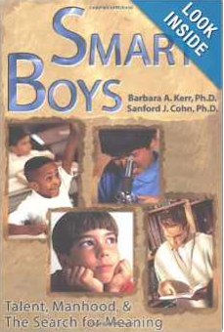

References
The Female Brain (2006) by Dr. Louann Brizendine, M.D.
The Male Brain (2010) by Dr. Louann Brizendine, M.D.
Why Men Never Remember and Women Never Forget (2005) by Marianne J. Legato, MD, FACP
Deborah Tannen (2013) http://www9.georgetown.edu/faculty/tannend/ http://www.youtube.com/watch?v=RwFsc7ZTvpI
Smart Girls-Gifted Women and MORE… Dr. Barbara Kerr, Ph.D. Univ of Kansas
Notes:
You Were Always Mom's Favorite!: Sisters in Conversation Throughout Their Lives
You're Wearing THAT?: Understanding Mothers and Daughters in Conversation
I Only Say This Because I Love You: Talking to Your Parents, Partner, Sibs, and Kids When You're All Adults
The Argument Culture: Stopping America's War of Words
Talking from 9 to 5: Women and Men at Work
You Just Don't Understand: Women and Men in Conversation
That's Not What I Meant!: How Conversational Style Makes or Breaks Relationships

Slide 33


Discussion
How does this information “inform” your Parenting? Teaching? Relationships?
How can you help kids overcome “gender barriers” to reach their potential?
What additional information would you like to talk about?

