Slide 1

Motivation and Underachievement:
How they Affect your High Ability Student
Kathy Paul
Extended Learning Program
Johnston Community Schools

Slide 2

Motivation: Essential to Achievement
Drive
Desire for success
Initiative
Interest
Dedication
Self-Direction clipart.com
Notes:
Motivation is the drive and desire for success. Requires: initiative, interest, dedication
Ability to have self direction
All are motivated, but not all motivated in school Lack of motivation is characteristic of most underachievers

Slide 3
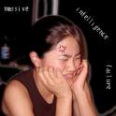
Demonstrations of lack of
MOTIVATION:
Daydreaming
Not doing work
Sleeping in class
Excuses for late or incomplete work
Negative body language
Poor attendance
Requests to leave class
Defiant clipart.com
Notes:
Common traits described by teachers/parents

Slide 4

Destroyers of Motivation
No expectations of success
Lessonsfromthemiddle.com
Notes:
Must believe he/she can succeed
Grades or test scores only source of success, motivation wanes
No expectation of success = motivation is destroyed

Slide 5

Destroyer of Motivation 2:
Fear of Failure
Googleimages.com
Notes:
Anxiety created by real or perceived threats of failure, rejection, or judgment
Perception is that results will end in failure, so not trying is better choice than possible rejection/failure
Failure looks better if not trying in first place
Feelings of alienation from peers and teachers

Slide 6
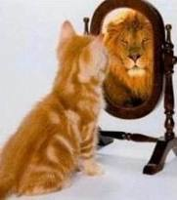
Without motivation,
it is almost impossible
to reverse
underachievement
www.enterpriseforkids.com
Notes:
Student who came back 4 years out of HS, (Naval Academy, major accolades) “I knew you cared, but I didn’t care about myself. It was only when I decided it was important to try that I did, but you were then there for me.”

Slide 7
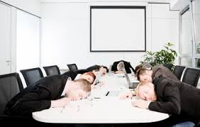
underachievement
“Chairman of the Bored” - self-image formed by 9 years
Underachievement is easier to reverse the earlier it’s caught
  Prevention through appropriate curriculum
  is even better
Counseling is key, but needs to start early
  Can bring about behavior changes
  and teach strategies for self-efficacy
Curtisagency.com
Notes:
I thought it was a conscious decision, could “outgrow” it,
Often worsens by middle school. May get better in HS IF student sees relationship between work and future goals
Males 2x as likely to underachieve, starts early. Girls often in 6th grade- more lacking in self confidence
UP to 30% of gifted underachieve
HS and college achievement are strongly connected
Grades more indicative than IQ as predictor of future success
Extra curriculars more common in achievers

Slide 8
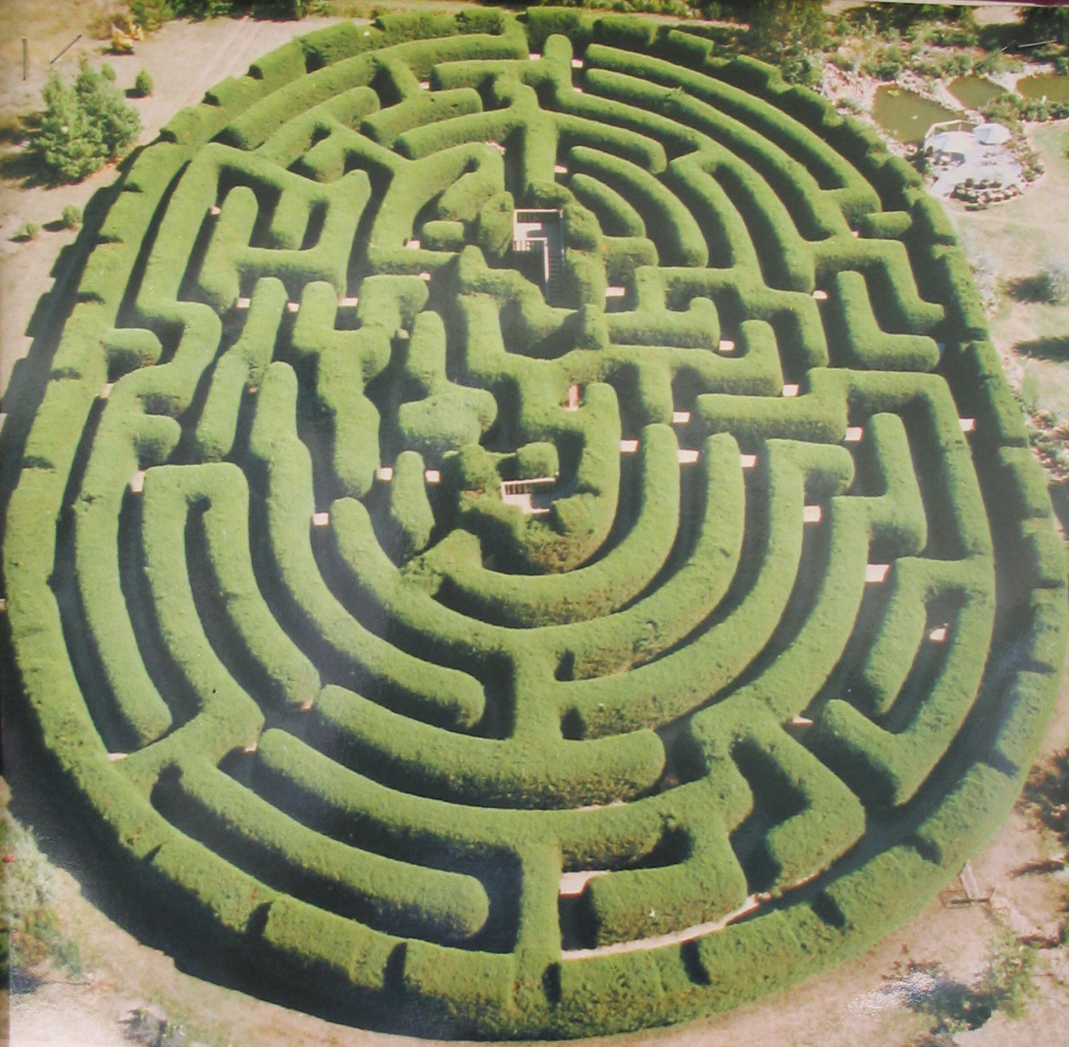
Underachievement is like a maze:
There are lots of blind alleys and more than one path to get to
the end!
http://en.wikipedia.org/wiki/File:Wandiligong_maze.jpg
Notes:
No one right answer to assist in resolving issue of underachievement

Slide 9
Definition: Achievement does not match ability. A capable, intelligent person who has learned to not perform to his/her ability. (Rimm)
Not easily defined–what is “true” ability?
Caused by BEHAVIOR rather than work habits or attitude.
  BEHAVIOR can change over time.
People often do not outgrow it.
If it becomes a pattern for over a year, intervention is needed. NONPRODUCERS vs. UNDERACHIEVERS (Delisle, 1992)
Notes:
Underachievement is a matter of perspective-
No single cause or treatment
A huge issue, not easy to diagnose
Varies among situations and subjects in many cases

Slide 10
Nonproducers vs. Underachievers
Nonproducers or selective producers choose not to attend classes or complete work because they consider work to be boring or irrelevant. At risk academically but not USUALLY psychologically.
Underachievers do not complete work because of low self-esteem and are often dependent learners. At risk academically and psychologically.
Whatever term used, they are not living up to POTENTIAL.
Notes:
Selective producers fit many children

Slide 11
Often an issue at an early age-
Dominance:
Adults expect social maturity because of advanced intellect; student sees academic situation changed “just for him/her” and becomes addicted to power and control
OR
Dependency:
School may not be appropriate challenge level, so student tunes out
Notes:
Dominance Often starts very early but may not be noticed by significant adults (who may be part of the problem)

Slide 12

Dependent
Conformers
Perfectionist– can’t start, can’t finish
Constant “overseeing” expected, as THEY
do not know what to do.
The AGONY Principal: Adults should never
agonize over a child’s behavior if the child is
capable of agonizing over it him/herself.
(Dr. Michael Whitley, clinical psychologist)
www.ivillage.com

Slide 13
Underachiever:
General Characteristics
Intelligence
Motivation: to fail. Not conscious. Lack self-awareness.
Lack the character-based skills to achieve success & self-esteem.
Substitute excuses for effective action.
Notes:
Lack of motivation may translate into motivation to fail, although not aware.
Let’s get to the WHY

Slide 14
Underachievers lack self-discipline to start a task
Do not consider future consequences
Do not direct behavior towards completion
Live in the moment
Notes:
Parent reported her adolsecent son was playing games on computer most of the time he was to be studying. “Do we have to monitor him every moment?”

Slide 15
Underachievers lack commitment
An emotional obligation to complete a task so it is well done
Use mild anxiety to remain alert and keep learning
Pace learning to reach goal
Notes:
They do not sacrifice for the future. Underachievers connect negative feelings with work. Easier to think of other things to do than study. Do not have positive feelings about study in school and overwhelm rational behavior with negative thoughts. So they underachieve again.

Slide 16
STRATEGY:
Organize the study environment at home
  Time
    Place- conducive to study, well-lit, central, no TV
    Near computer-- visibility
    Supplies
    List of what is needed for each class- Pilot before takeoff
    Can even use a luggage tag
    Dual-ing textbooks!
    Book bag without a bottomless pit– ownership from student
    “portable office”
    Dividers/notebooks. What works best?
Notes:
Whether or not student has homework, this is where you go at this time
Check with teachers as to supplies/add to notebook for that course
Easy when text is online to have access
Can even by folders which have vertical tabs/alignment

Slide 17
LISTS!
Daily or weekly “To do.” Teach this skill. Can be on portable device or paper, but must be used. Need a way to “check off” items
Assignments: MUST write them down/dictate them.
Can even use a sticky-note to write on the textbook or notebook.
Parent list: Check this– reinforce effort!

Slide 18
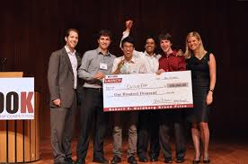
They are generally “good” kids!
Promise to do better
Ignore the voice inside reminding them to “do their best”
Value success, just do not see how it is attainable to them
Googleimages.com
Notes:
May expect to be in control and center of attention
Becomes angry when reasonable discipline is exerted.
You need to believe in them

Slide 19
Underachievers fail to accept responsibility for themselves
Blame others, often parent vs. parent or teacher vs. parent
Fail to develop and take command of their feelings
Great difficulty with competition; can’t accept failure
  Cry, complain or brag when they win. May have peer issues because they have to be “first.”
May exhibit perfectionist behaviors -- won’t do it if they can’t do it just right OR may appear to have spent no time on a task
Notes:
Class or teacher is boring
Parents may establish this early by being inconsistent in message or saying they were like that also

Slide 20
“Parents to the Rescue” syndrome
Carolyn Coil, expert in underachievement, recommends coming to aid of a child for a “school” issue:
K-2 Once every 2 weeks
3-4 Once a month
6-8 Once every 9 weeks
9-10 Once a semester
11-12 Never
Notes:
Did not bring lunch, my students ate school lunch

Slide 21
Underachievers lack independence
May function well if constantly supervised, but do not plan or organize their school responsibilities
Develop dependency– force others to make decisions to avoid taking responsibility
Leads to emotional level dependency– why worry when others will do it so much better FOR you?
Wait for others to create a solution and then fail to follow through… “I don’t know” is an easy answer
Notes:
Missing a deadline invites more supervision, fuels dependency.
Do not engage in the process of thinking productively about problem solving

Slide 22
Underachievers fear feelings of personal responsibility
See challenge and responsibility as threats
Anxiety created: What if I can’t do that again?
Turn making excuses into an art form: “victim mentality”
  External excuses (teacher, text) destroys self-esteem
  Internal excuses (forgot, lazy) leaves them unable to make conscious choices
Hostile towards success and learning, don’t see themselves as having control of their own emotions or thoughts.
Notes:
Excuses destroy self esteem by robbing them of sense of power– create helplessness

Slide 23

Difficulty changing negative into positive feelings
May be led (forced) to work harder, but cling to feelings that work is bad
No positive emotion tied to working
www.workingmystic.com
Notes:
developing self-discipline and
self-mastery of emotion is crucial to
become an independent learner
Start early!

Slide 24
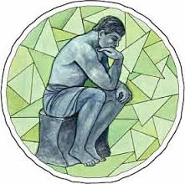
Lack Insight
schol.wordpress.com
Self-ignorance causes pain and discouragement– they literally don’t have a clue
Lack ability to reflect, do not know who they are
Why don’t they turn in work they actually complete? May fear rejection from others, disapproval, believe it’s not socially accepted.
Rely on fantasy rather than truisms
Conflicted
Notes:
Conflict occurs because : If they can avoid learning about internal conflicts then they will never have to resolve conflicts through decisions. Instead, they continue to make passive choices

Slide 25

Does this sounds like anyone you know?
Think of your child. What has been tried? What has worked– or not worked?
news.vietboom.com

Slide 26

Underachievement is a choice
Often not aware of it, do not see the truth
Unable to change without assistance and self-recognition
www.futurestartup.com
Notes:
Good news: There are ways to help and students CAN change

Slide 27
Parents should not shield or protect children from risks or hard work. Parents also need to allow children to experience tensions and stress that rise from challenging ideas and high expectations.
- Olszewski-Kubilius
Notes:
Paula Olszewski-Kubilius, editor of Gifted Child Today

Slide 28
Lying: The Path to Self-Defeat
Lie about school = lie about what is really wrong inside
Adults focus on externals, such as homework and grades, rather than what is making them feel inadequate or unable to deal with pain
Cycle of discouragement and defeat
Notes:
Adults must deal with lying, do not ignore this symptom

Slide 29

To reverse the cycle?
Persistence
Patience
Positive Attitude
Parents & Teachers
  Work together
  Make no excuses
  Set the values
  Change child, not setting
  Learn to deal with pain– we live in a competitive world
  Promote pursuit of passions– early goals and success can be replicated.
sc.studentboss.com
Notes:
Related problems may need to be dealt with

Slide 30
Motivate through self-management
WE cannot make the change, but we can perhaps be the catalyst
Teach methods, strategies or skills for students to direct their actions toward achievement of goals;
  Persistence
  Independence
  Goal Setting
  Time Management
  Study Skills
  Effective Technology skills
Notes:
Help child to see their strengths– build on them

Slide 31
Strategy: Tackle Long Term Assignments
Turn the expectations/assignment into a written checklist and schedule.
Break the assignment into smaller parts and turn parts in early, if possible. Will need to talk to the teacher about this. May need to go into a “vault” to hold for safekeeping until DUE DATE.
Develop a list of resources and supplies needed.
Student should be able to state the final goal or outcome in writing or orally to be scribed. If there are lots of choices or flexibility, break those down into concrete ideas.
Are skills present: Note taking, resource finding, bibliography, citations, rough draft, proofreading, etc.
Notes:
DO NOT ASSUME THESE SKILLS ARE PRESENT

Slide 32
Strategy: Help children see their strengths checklist from Coil’s Becoming an Achiever(2004)
Communicates problems & works to solve them
Listens to those who have authority
Can see more than one solution to a problem
Has an area of interest
Chooses peers who are achievers
Is a risk-taker
Has a belief in self
Takes responsibility
Shows creativity
Is persistent in working on a new task
Is able to comprehend difficult reading material
Notes:
Build on the positive. Develop a checklist for your child to physically see traits, have them complete it. Emphasize strengths. Then work on a few weaknesses at a time.

Slide 33

A word about “PRAISE”
“Best or brightest”… not the BEST idea.
Format praise to be specific: “Look at how clearly you’ve explained the process of how you solved this problem. You have listed each step in order so I know exactly what you were thinking” vs. “Good job on problem number 3.”
Don’t praise for little effort, something thrown together at last minute. Praise when improvement shown.
Compliments should be related to effort or outcome, not vague generalities.
www.psdgraphics.com
Notes:
When has praise worked the best for you? What was said? Why did it work so well?
Underachievers do not hear praise often, and generalized praise is usually interpreted as insincere. Give compliments for attempts not only finished products

Slide 34

Which type of praise?
Stanford researcher Dr. Carol Dweck’s Mindsets: Fixed or Growth- belief in one’s own ability
Praise for being SMART = choose easier task next time, need to “stay smart”. View failure as a sign of low ability and give up.
WE say: You learned that so quickly. You are so smart.
THEY hear: If I can’t learn something quickly, I am not smart.
WE say: You must be the best writer in your class. Googleimages.com
THEY hear: I should not try to write anything more difficult or I may not stay the best. That was good enough.
WE say: You got an A without trying! Brilliant work!
THEY hear: No need to study. I am smart enough.
Praise for effort/hard work= choose more challenging task. Believe they can do it.
“You explained every step of that math problem. Now I see how you solved this problem.”
“You worked for hours on that project and look at the expression in your writing. Your PowerPoint slides are clear and the person who hears and reads this will be able to learn a lot.”

Slide 35
Communication between students, teachers, and parents
Chances of success greater if parents and teachers cooperate
Parents often disappointed and feel helpless
BOTH environments are likely reinforcing underachieving patterns, both parents and teachers must change their approach to these children
Parent-Teacher conference sets the stage for important alliance – both concerned for the child, care about the child, and understand it is a complex problem
Notes:
Communicate with all teachers regarding your child. Teachers talk, but info is not always relayed.
Use conferences as a chance to check in but do not expect lengthy time unless you have asked for it. Be careful to not be all negative, avoid humiliating child. May need to come without student

Slide 36

It’s not whether you win or lose but how you play the game!
“The ability to function in competition is central to achievement.” (Rimm, 124)
Need to learn that failure can be temporary
Respond to a loss, but wait until after emotional tension is reduced to begin a dialogue
School and life are important “games,” but much to be learned from sports and music
Notes:
Increased risk taking– trying something you may not do well in – positive outcomes, even when you fail…you learn

Slide 37
What to say when children succeed with little or no effort?
“It’s great that you can do that. Now we need to find something a bit more challenging so you can grow.”
Or
“It looks like your skills weren’t really challenged by this project. Let’s look at what you could do next.”

Slide 38

What does often NOT work?
Logic – underachievers know values but do not see how they apply to themselves or are not able to follow through
Rewards & Punishment (external events) – bribes & grounding teaches that parents are in control of the child.
  Encourages them to work for wrong reasons– does nothing to establish self-efficacy, may take the place of understanding what drives underachievement
Tutoring – If student really has the ability, causes greater dependency. Only works if student is eager, teacher is able to relate well to child, and it is supplemented by other strategies
“Suffer the Consequences” – i.e. fail a test, etc. They repeat the same cycle. They substitute excuses for action. They don’t know why they fail, so they try to make better excuses. They assume no responsibility.
www.gettyimages.com
Notes:
Lectures, explanations. Most of the time eyes glaze over
Tutoring in deficit area: Small groups or one on one, will succeed because they are dependent upon leader. Once this goes away, it continues. Tutor must be versed about issues and be able to help the student progress quickly
Last one was hardest /is hardest for me to accept

Slide 39

Types of underachievers
(Whitley 51-145)
Who are they?
mychildguide.net
Notes:
This book brought to my attention by a parent, several have found it to be very helpful

Slide 40

The Procrastinator: wastes time & puts off tasks until it is too late
Power struggles and cycles of self-defeat
Blame others or circumstances
Seek to escape reality. May comply, but so slowly that it escalates the problems. May become angry at self and become discouraged which causes performance to slip.
Avoid expressing their negative feelings—it’s all about others “impossible” expectations. They transfer their negative
feelings to others.
Believe they did not do anything offensive
Usually initially encouraged by parents– “I was
a poor student, too.”
www.homeorganizeit.com
Notes:
Homework is in locker, don’t go until too late to get to class on time. don’t ask to go til end of class. Really it is our fault that we put the locker so far away
-Passively forget to do a task -Rarely refuse outright, just never get around
-Consummate victims
At the core are self-defeating beliefs about anger, disappointment, and expressing their desires

Slide 41
What to do for the procrastinator?
By mid-teen, they have developed a desire to be controlled but at the same time their conscience demands independence
Don’t accept excuses—environmental perception can be changed
Both authoritarian and unassertive adults will have issues: “cracking down” backfires as does leaving them alone
Help them learn healthier ways of dealing with aggressive feelings and anger
Change relationship: Sustained encouragement but still setting limits. Invite a relationship, but spell out what behaviors you want
Model success and teach goal setting techniques
Be patient and persistent, remember the child is not aware of their underlying feelings
Notes:
Failure happens as a result of something else and you’ve just proved it

Slide 42
Conversation to use with a sports-minded student who is not succeeding in school:
Counselor: Let’s talk a little about your team. How do you feel when a talented member of your team comes to practice late, skips practice, or doesn’t seem to play his hardest?
Student: It infuriates me because I know he could help us win if he used even half his talent.
Counselor: How do you feel about average guys or really talented players who are positive and practice hard?
Student: I’m really glad to have them on my team. I can count on them, and even if they mess up, I know they did their best.
Counselor: How do you think your feelings compare to your teachers’ attitudes about the minimum amount of work you’re doing?
Student: (There’s a pause as a light comes on) Okay… I get it!

Slide 43
Dealing with an angry, non-conforming child:
They may bond with adults they perceive as strong enough to respect, providing the adult can get through defenses and communicate that they value something inside the child
Dominant students are used to pushing limits, so you have limited circumstances you can control: homework, detentions, punishments usually don’t work. Sincere praise, inspiration, even rewards if mutually agreed upon (student then feels some control) and persuasion might.
Brief personal and confidential talks.
Set short term attainable goals and agree on positive and negative consequences. Write down the agreement (contract) and make 2 copies.
Stay firm with the consequences. Do not amend with further reward or punishment.
Notes:
This may work for a respected teacher also

Slide 44
Anti-Arguing Instructions- for the “I’m smart, notice me!” student
May pick worst time for retorts (right before bedtime, when needing to go on to another activity: “This assignment/ chore /activity is dumb. There’s a much better way to do this.” Respond with an alliance “I’d be very interested in your ideas.” Ask them to elaborate, but don’t judge.
“Let me think about that, I’ll get back to you in _______” is a way to get started.
Is there a way to compromise on the idea? “Part of this sounds workable, let’s write this down and agree on what we can do.” IF homework, talk about how they can approach a teacher IN THE FUTURE to request a modification.
If it’s just a ploy to avoid work, “No” may be the only response but explain that you’ve thought about it and value the idea and would like to hear more ideas in the future. Then stop. If arguing persists, excuse yourself and leave.
Follow same steps for each future arguing attempt. Children will value that you listen to them.
Notes:
Don’t put them in their place– it only destroys any possible relationship

Slide 45

The Hidden Perfectionist
Not perfect in work habits!
Unrealistic in what they should do because they can not live up to ideals.
Worried and compulsive. Indecisive and unsure.
May fear breaking the rules early on, so get good grades. Feel forced to work, never assimilates pleasure with work.
Low self-esteem may be masked by arrogance and depression.
Test-anxiety often present.
livingunderhighvoltage.blogspot.com
Notes:
Parents often very controlling, lots of rules
Lack communication and expression of emotion, become angry. Resent school due to more rules.
Want approval

Slide 46
What to do with the Hidden Perfectionist?
Set clear expectations
Look at rules. Too many rules may cause a great deal of problems. Self-regulation should be your intent.
Help them regulate inner conflicts appropriately, connect with feelings of anger and anxiety, and learn to express these emotions.
Teach them to manage their own goals and affairs
Show that you care. May be hypersensitive to rejection.
Notes:
Often have self-defeating/revenge-seeking behavior so will take time to change
Power-struggles or frequent approval seeking are common

Slide 47

The Martyr
Punishment = security through contact, usually from parent or other significant adult. May not realize pattern is being set.
Most difficult to deal with, reject assistance and react poorly to success.
Reject help– worst “project,” tend to sabotage.
May have short-lived enthusiasm, as they revert to failing behavior.
Associated with failure to accept help: medical, psychological issues.
Helpless and hopeless. Regularly sabotage all assistance.
Notes:
Usually start the year out well, then revert
Boredom but no idea as to what to do—so we give them something to do, remains dependent
A followed by an F
Failure is security,

Slide 48

What to do with the Martyr?
Feelings of rage need to be controlled
Break cycle of dependence upon punishment = security
Be available/steady, maintain your own sense of self-worth in order to assist child
Beware of severe depression
Look for professional help
www.worklifedesign.com

Slide 49
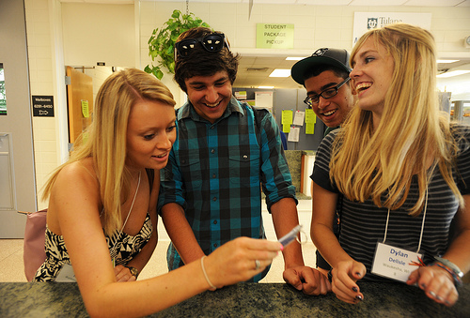
The Socialite
Value approval, praise and attention more than their own educational goals and self-interests
If they can’t get positive attention, then they will get negative
Instant gratification
Hide true feelings
Often class clown
Believe they are inadequate
Little insight into past behavior
www.broadnecksociology.edublogs.org
Notes:
Surprisingly very competitive, uses” friends” to form alliances
“Scarlett O Hara” befriends Miss Melly to undermine her competitiveness

Slide 50
What to Do with the Socialite?
Behind the façade, there may be depression
How can you provide them power and an audience that is appropriate?
Usually sacrifice grades for social acceptance--so grounding or missing lunch deprives them of outlet to get rid of depression and just deepens resentment
Need someone to identify and explore hidden feelings
“I can see you are feeling badly and need my attention”
Great potential for change
Provide ease for self-evaluation: chart own progress in both effort and academics (read at desk 10 more minutes, 90% on test, etc.)
Notes:
Work with younger students is a good way to get positive attention. Usually NOT peers, as they become judgmental.

Slide 51
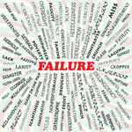
The Shy Type
Fear embarrassment and humiliation so much that they protect themselves from real failure
Will engage in challenge only when assured of success
Often not noticed in class, rarely assert selves
Have an excuse: fail from lack of trying
School phobic
Become dependent upon adults
Notes:
May develop other phobias
Make themselves dependent upon teachers as well as parents

Slide 52
Conversation with an 8th gr. student about his inability to remember to complete make-up work. (Wanted to be in advanced courses, but was getting C’s/D’s in several courses) “When I am gone, I forget that I have anything else to do. I remember that I have work for the current day, but not from when I was gone.”
How do you usually remember things?
TIM: I just have it in my head.
Does that work with make-up assignments?
TIM: I guess not.
What else could you do to remind yourself?
TIM: Well, I’ve tried writing it down but that doesn’t really work. And my parents aren’t home when I am supposed to be doing my homework right after school. They reminded me when I was little.
Notes:
Wanted to just offer advice: easy, just use a calendar, notebook, etc. For him, not easy or obvious. A break though in my thinking.

Slide 53
How do others remember things?
TIM: I have a friend who was gone for about a week and he got his work done right away. He’s really smart. I suppose I could ask him what he did.
How do your parents remember things that they need to take care of for their job or family?
Tim: They usually use their phone.
Do you have any ideas of what you could do to help you remember important things that aren’t routine?
Tim: Not really, but I could think about it.
I made an appointment to check with him in 2 days. He reported he’d talked to him friend and then decided to use an app on his phone. Follow up was 3 days, then 4 days later. As of 2nd to last day of school, he had no outstanding make-up work. This year, grades are A’s and B’s.
Notes:
Possible success? Previously would have offered advice– I know what to do, I am a successful adult who NEVER misses obligations. Conversation didn’t take more than a few minutes, as did follow up, but I HAD TO MAKE AN APT to ensure we did meet.

Slide 54
What to do with the Shy Type?
Parents may also fear failure. Start slow, don’t push too fast for success
Help them break from their comfort zone. Don’t protect them from every anxiety, but let go in measured doses.
Discuss fears and learn to identify the factors that inhibit their lives
For older child, persuade them to get help, overcome mild depression
Notes:
Counselor may provide support

Slide 55
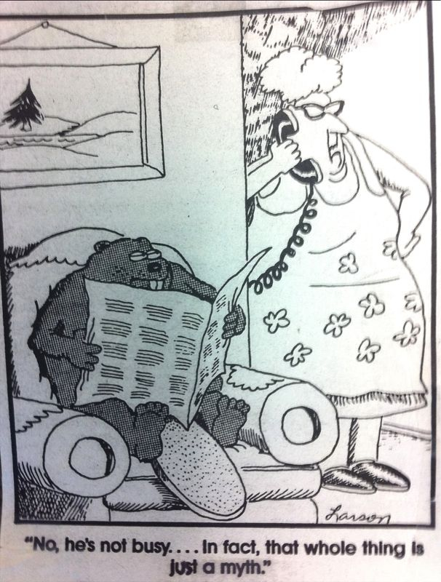
The Con Artist
Appear to have a great deal of charm, but manipulative
Want good grades, but not willing to work
“Let’s Make a Deal”
Self-centered, too boring or beneath them
Contracts rarely work, they are above the
working class
Lonely and jealous, Scrooge
May start early with parents who set few
limits, learn to exploit and bargain
baileysbuddy.blogspot.com
Notes:
Special people who should be treated specially
Will go to best college even though failed algebra

Slide 56
What to do with the Con Artist?
Often resist help
Can take a long time and require professional help
Consistent external discipline: teach decision making, self-pacing, goal setting
Systematic consequences between parents and school
Have to be pushed so that the old familiar tactics do not work and then they can face their self-esteem issues. Freedom to make choices (even to waste time). Encouragement when making good choices that are positive. Gradually impose more structure.
May be able to foster social relationships with a few selected peers, encourage special interests
Notes:
Confront reality vs. fantasy

Slide 57
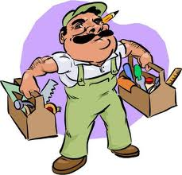
Your Toolbox
(Kanevsky & Keighley 23-25)
remont-stroitelistvo.freeadsin.ru
Control- Confront the child with the reality of the situation: values, alternatives, consequences. Students must value their goals in school, believe they can do it. This can be taught. Show ways to break down goals, teach problem solving systems, including setting priorities.
Choices- Follow by self-evaluation. Gradually move towards higher goals. Model templates for handling similar situations with each new choice that is made. Discuss ideas for making choices.
Challenge- Provide intellectual challenge. Appropriately differentiated programming = potential achievers.
Complexity
Care- Talk to students about their goals and their gifts. Model upbeat self-talk, enjoy victory. Learn from defeat. Celebrate small gains. Share your life experiences, frame roadblocks as challenges. Model ways to mentally recharge and sustain enthusiasm.
Notes:
Control vs. Choice: Control related to implicit distribution of power. Choice focuses on explicit opportunities to act on preferences.
May create challenge: skip homework if can still meet requirements or pass tests. Skip classes another frequent issue.
Complex : rich, messy content, high level thinking. Stick with a topic when interested. Requires flexile, self- determined pace at times.

Slide 58
ALLIANCE: Reversing Student Underachievement (Rimm, 153)
Ally with the student privately about interests and concerns
Listen to what the student says
Learn about what the student is thinking
Initiate opportunities for recognition of the student’s strengths
Add experimental ideas for engaging curricular and extracurricular activities
Nurture relationships with appropriate adult and peer role models
Consequence: reasonably but firmly if the student doesn’t meet commitments
Emphasize effort, independence, realistic expectations, and how strengths can be used to cope with problems, and extend possibilities patiently
Notes:
Rimm has long experience in working with underachieving gifted

Slide 59
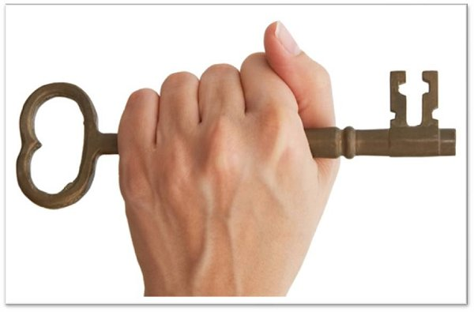
Parents and Teachers have similar goals:
Able to contribute to our child’s success
Unlock and nurture potential
www.atlanta.k12.ga.us
Notes:
Believe in the time it will take to explore underlying feelings, values, motivations. WE want instant satisfaction also.
Have faith in yourself, and in your child. Good things take time!

Slide 60
Resources
Clinkenbeard, P., Delcourt, M., & Diegle, D. What Educators Need to Know About Student Motivation. Retrieved Nov. 14, 2012 from: www.gifted.uconn.edu/nrcgt/reports/trifolds/a9509p.pdf
Coil, C. (2004). Becoming an Achiever, A Student Guide. Marion: Pieces of Learning.
*Coil, C. (1992, Revised Expanded Edition). Motivating Underachievers. Saline: McNaughton & Gunn, Inc.
Dawson. P. & Guare, R. (2009). Smart but scattered. New York: Guiliford Press.
*Delisle, J. (2011). Tips for Parents: Doing Poorly on Purpose: Underachievement and the Quest for Dignity. www.davidsongifted.org
Goldberg, D. (2005) The organized student. New York: Simon and Schuster.
Heacox, D. (2014). Differentiation for Gifted Learners. Minneapolis: Free Spirit Publishing Inc.
Heilbronner, N. (2011). 10 Things NOT to Say to Your Gifted Child: One Family’s Perspective. Scottsdale: Great Potential Press.
Kanevsky, L & Keighley, T. (2003 Fall). To Produce or Not to Produce? Understanding Boredom and the Honor in Underachievement. Roeper Review 26, 20-27.

Slide 61
Resources, cont’d.
Moss, S. (2007) Where’s my stuff?. San Francisco: Zest.
Olenchak, G. (2008). Counseling to Deal with Underachievement. NAGC in Florida. Powerpoint.
Rimm, S. (1986). Underachievement Syndrome, Causes and Cures. Watertown: Apple Publishing Company.
Rimm, S. (2006). When Gifted Students Underachieve, What You Can Do About. Waco: Prufrock Press, Inc.
*Rimm, S. (2008). Why Bright Kids Get Poor Grades and What you Can Do about It. (3rd ed.)Scottsdale: Great Potential Press.
Siegle, D. (2006 Winter). Parenting Strategies to Motivate Underachieving Gifted Students. ITAG newsletter, 31, 19.
Siegle, D. (2013). The Underachieving Gifted Child. Waco: Prufrock Press, Inc.
**Whitley, M. (2001). Bright Minds, Poor Grades. New York: Perigee.
Whitmore, J. R. (1998). Gifted Underachievement. NAGC speech
Notes:
Starred resources are highly recommended

