Slide 1
Differentiation in K-12 Classrooms
Matt Robie
ITAG President
October 6, 2014
Notes:
Talk about how Luke introduced himself to Abby – I’m Luke and I’m in AELP. We had to have a conversation about the fine line that exists between being proud and bragging. You don’t talk about yourself unless someone asks. Now I’m going to talk about myself. ☺
Introduce myself (so that you have a clear picture of the lens that I bring with me to a talk like this) – my teaching history, ITAG, Drake courses, EdAdmin degree + my family
I wanted to jazz up the presentation, trying to decide between countless analogies, YouTube videos (my wife said that if I play several long videos, it gives the impression that I’m trying to fill space to hide that I don’t know what I’m talking about – then she covered), role-playing (introverts, easily embarrassed)
In the end, 6 analogies, a couple videos, 3 examples, a non-example, and no role-playing. ☺

Slide 2
Dear Parents,
…My goal is to differentiate so as to meet the needs of all of my students, so I’ll be using many different teaching and learning strategies over the course of the year. I hope that you’ll see your child learning and enjoying school. Please do not hesitate to call or e-mail with your questions or concerns.
Eidson, 2008
Notes:
It’s the first week of school, and you receive the following note from your child’s teacher:
Your first thought is, “This sounds great.” And it’s likely that your second thought is, “But what does it mean for my child?”
I always smile when I hear the name of your group, “Friends of Johnston ELP”. Your name leaves no doubt as to what the purpose of your organization is. I smile because I recognize that I have a habit of standing up for teachers in any conversation I have outside of school. Even if I don’t know the teacher. Talking to family – whatever happened, I assume positive intent.

Slide 3
Assume positive intent.
Notes:
My first piece of advice this evening is that you always start here. Star this is your notes, hang it on your fridge, tweet it to @MatthewRobie or @IowaGifted
For three years, I taught a graduate course at Drake about differentiation. My audience was practicing teachers, or perspective teachers. I could stand here tonight and talk about different ways to differentiate the student’s product, process, or content. But because you are a room full of parents, I want to steer in a bit of a different direction. Tonight, let’s talk about what differentiation is, and how to start and maintain a conversation with your child’s teacher when you think there might be a need.
Show “it’s not about the nail” - It’s easy to get adversarial when you don’t think the teacher is understanding your child’s needs. But you have to constantly remember that you’re on the same side. You may have different opinions about how to get the job done, just like the couple in the video – but you both want the SAME THING. Please assume positive intent.

Slide 4
One definition of differentiated instruction
A teacher’s response to students’ needs as defined by their readiness, learning styles, and interests.
Notes:
The goal is to provide challenge and success for all learners. Differentiation is based on the notion that, in order to learn, students need to experience a bit of challenge and that when work is too easy intellectual growth is impaired or, perhaps, even impossible. (Talk about Lauren?)
For example, through a pre-assessment, Mrs. Smith learns that five of her students have already mastered the math content she plans to teach this week about area of triangles. So she gives those five students a set of difficult problems – what our generation called “word problems” that involve applying what they know about area of triangles. While the teacher is explicitly teaching the rest of the class the content, this group of five is individually struggling with their set of problems.
I say “struggling” on purpose. I’ve heard it called “productive failure” or “failing forward” or “productive struggle” – but it’s all about…

Slide 5
When you steal a student’s struggle, you steal their learning. When you support the struggle, you take them farther than ever.

Slide 6
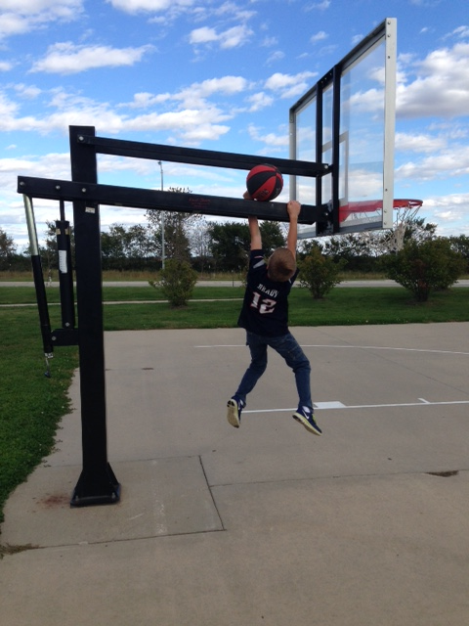

Slide 7
When you steal a student’s struggle, you steal their learning. When you support the struggle, you take them farther than ever.
Notes:
So after 15 minutes of “productive struggle” – the students convene with each other in a corner of the room. They explain their reasoning, defend their solutions and methods, and try to come to consensus regarding the solutions. Towards the end of the period, the teacher meets with the group to share solutions and teach content and/or problem solving skills that the group of students needs. In an ideal setting, these students leave with a problem for homework that asks them to then practice that new learning.
In this example of differentiation, the teacher has executed what I believe to be two non-negotiables for gifted students:
1. Gifted students need instruction and support. Notice that this quote doesn’t say that “when you leave them alone to do independent work, they’ll take themselves farther than ever.” and…

Slide 8
Every child deserves to learn something new every day.

Slide 9
How do you know?
Listen to your child. Does the work seem in her grasp if she applies herself?
Does your child talk about working with different groups of students?
Notes:
First bullet: Talk about when I would assign Level 3 spelling words

Slide 10
A non-Example
cynosure (synosure): An object that serves as a focal point of attention and admiration.
commissar (commasar): An official of the Communist Party in charge of political indoctrination and the enforcement of party loyalty.
graupel (grouple): A snow pellet.
voortrekker (vortrekker): One of the original Afrikaner settlers of the Transvaal and the Orange Free State who migrated from the Cape Colony in the 1830.
weissnichtwo (weisnichtwo): An indefinite, unknown, or imaginary place.

Slide 11
How do you know?
Listen to your child. Does the work seem in her grasp if she applies herself?
Does your child talk about working with different groups of students?
Notes:
Second bullet: Grouping cannot be static. There are times when gifted students are in enrichment or extension groups, but also times when they might need reteaching. Or there are times when students are best grouped by interest.
All any parent wants is to know that teachers truly know their students. When you hear your child talk about working with different groups of students, it likely means that the teacher is using regular assessment to guide her instructional decisions.

Slide 12
What you don’t want to hear
The bulk of his time is spent working independently with no peer interaction or teacher support.
He is frequently tutoring other students.
If his behavior doesn’t improve, he won’t get to work with the ELP teacher.
It wouldn’t be fair to the other students.
Notes:
Unfortunately, these are the go-to for some teachers.
Second bullet: That’s not their job. They have the right to come to school, and learn.
After third bullet: Show “naked grandma” video - plus maybe show the “girl doesn’t want her brother to grow up” video
Meeting children’s needs is not a reward.
After fourth bullet: Here’s where I start drawing analogies. I’m a doctor in an urgent care clinic. There’s a bug going around, and a lot of people are coming in with the same symptoms. I’ve been prescribing a lot of Zpac. On one night, Zpac is an appropriate prescription for 80% of my patients that night. But then Sarah comes in with chest pains, and Scott comes in with broken ribs. If I prescribe Zpac, I am not meeting their needs. And that’s a mild way of saying it. I am committing malpractice if I don’t differentiate for my patients.
I’m a financial planner, and I’m in love with a certain mutual fund. Every client that comes in, I put their money in this mutual fund. It’s going to serve the needs of the majority of my clients, but not all. My clients on the verge of retirement need to be in something different than my 16-year client with $1000 to invest. I differentiate what I do for these clients.
I’m a football coach. There are times when the whole team is doing the same thing. All players need to stretch, so when stretching they can be grouped heterogeneously. They all listen to the same pregame speech, so it doesn’t matter how they are seated in the locker room. But conversely, there are times when the kicker needs to work with the other kickers in an area of strength. The receivers practice running routes and catching passes (their strength area), and the linemen practice technique with other lineman. If I don’t differentiate my practices, they will not improve, and we will lose.

Slide 13
Approaching the teacher
Assume positive intent
Avoid emails
Give the teacher time to process
Set goals together
Be solution-focused, come with ideas
Notes:
Second bullet: It’s very difficult for parents of gifted children to talk about their child’s needs without coming across as conceited, elitist. Others think they are bragging, or concerned about the ELP label. Emails are fine, but you can’t interpret tone, so don’t let a string develop where the relationship seems to be getting more and more adversarial. Schedule a meeting or a phone call.

Slide 14
Questions to ask
How is my child growing in this subject area?
Can my child have the chance to show you what she already knows and can do?
If my child already knows a lot about a particular topic and has clearly mastered the associated skills, what other possibilities exist for him or her?
Notes:
Second bullet: Preassessment is vital to differentiation. Vital.
Third: Examples
Ben, a kindergarten student is reading well above grade level. About 90% of kindergarteners come in as pre-readers, and letters their sounds is very appropriate instruction for most. There are certain centers that are naturally differentiated, writing as an example. But when most students are pairing uppercase and lowercase letters, Ben is instead asked to read on-level text with a certain purpose and journal back and forth with the teacher (or a student in a different grade level or classroom). When most students are building their sight word vocabulary, Ben and another student are working on an inquiry project about tigers, with clear checkpoints along the way where the teacher instructs them about nonfiction text features.
A geometry teacher has set up a structure in her room where students can prove mastery and work at a faster pace. After five months, Kelly has proven mastery of the entire school year’s content. Kelly’s teacher knows that Kelly wants to be a physical therapist when she grows up, so she and the school’s ELP teacher set Kelly up with a PT mentor who guides Kelly in an informal study of anatomy during her scheduled geometry class.
Of course, this is one option. Kelly’s teacher can also instruct Kelly around deeper geometric concepts or immerse her in problem based learning around a topic. Depending on the district and the student needs, acceleration to Algebra II might be an option. The law says that you must have a program that provides for the needs of gifted students, but it’s up to individual districts to decide how.
The point is…

Slide 15
Another definition of differentiation
Recognizing that a student needs something different, and doing something about it.
Notes:
Kelly’s teacher is recognizing that she needs something different, and she’s doing something about it.
Thanks so much for allowing me to visit today.

